Slide 1
ISLA Leiria, Lurdes Castanheira Wp 4: quality committee

Slide 2
Partners in the QC
One representative from:
Mutah University (MU)
Tafila Technical University (TTU)
Int@E UG
Jordan University of Science and Technology (JUST)
University of Jordan (UJ)
Instituto Superior Leiria (ISLA): Leader
One Quality Manager

Slide 3
Aim of the QC
Verification and timely detection of problems that might appear within the framework of the activities of Job Jo.
Monitor and evaluate the progress of Job Jo and ensure that all activities are properly enacted in accordance with the European Standards and Guidelines for Quality Assurance in Higher Education.

Slide 4
Quality Manager
Will design a proper evaluation process and be responsible for creating a set of indicators;
Sets the criteria for the selection of members of the External Evaluator (in coordination with the PM and other consortium members);
Sets the terms of reference and ‘rules of engagement’ that will govern the External Evaluator evaluation;
Is controlled and directed by the QC.

Slide 5
External Evaluator
Will conduct constructive evaluation by working according to the terms of reference and ‘rules of engagement’ set by the project QM and PM;
Will advise and train partner universities to use suitable tools of evaluation for the sustainability of the program quality;
Will write intermediate reports, one each 6 months, to re-address the project in case of going off from indicated objectives and methodologies.
Will conduct the evaluation beginning of 2020

Slide 6
External Evaluator
Mid-term reports, based on project documents, analysis of outputs and achieved results, stakeholders interviews and context analysis, considering:
Relevance
Efficiency
Effectiveness
First impact
Sustainability
The report will consider cross-cutting issues (such as gender and minorities rights).

Slide 7
Monitoring Committee (MC)
The monitoring committee has to:
Check the quality and conformity of the teaching material to market requirements;
Verify the compliance of training sessions to its scheduled time and the quality of teaching;
Confirm that the dissemination activities are developed in accordance to the project.
Composition: 8 persons, one from each University Partner.
The contractor of the project will determine the composition of internal experts from EU partners, which will monitor the quality of the work done.

Slide 8
Project Expected impact
Make south Jordanian Universities an essential asset in its local community through the promotion of employment in the region.
Multiplier effect will solve various social problems
Extension of project to the north of Jordan
Network between partners will maintain and cement the change
Target groups
Students, unemployed youth, teachers

Slide 9
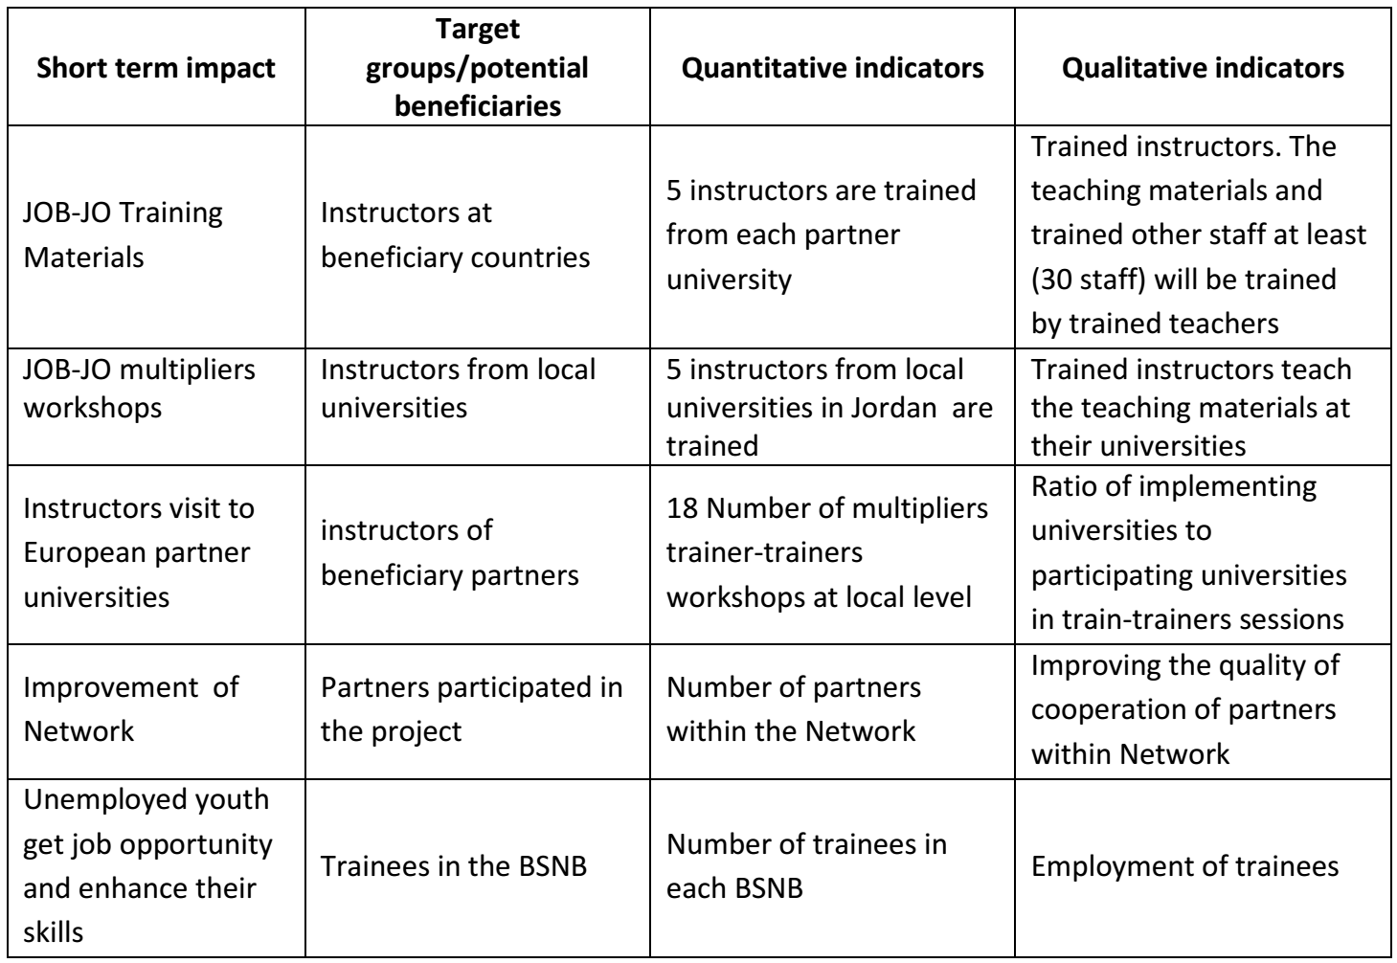
Short term impact indicators

Slide 10
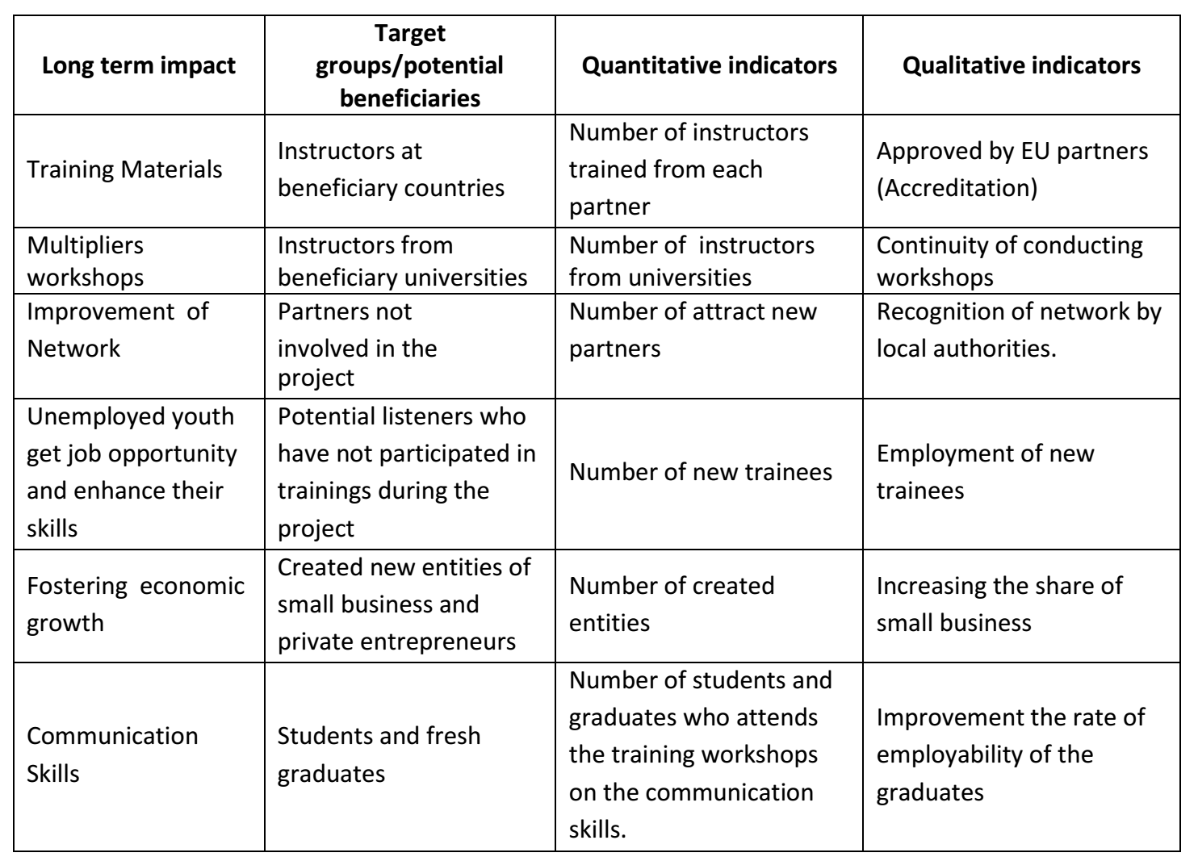
Long term impact indicators

Slide 11
Meetings and reports
QC will meet regularly every 6 months;
MC will meet in each of the BSNB, 3 times during the project period.
EE will write intermediate reports, one each 6 months, and a final report
Monitoring reports will be provided to the local coordinator for a summary, who then will pass it the contractor

Slide 12
ISLA as leader of WP4
Will monitor the project at different points, using different types of evaluation methods,
Exploratory, to support the process
Experimental and quasi-experimental design, to evaluate the outcomes
Summative final evaluation will include
Impact study
Benchmarking study

Slide 13
Controlled Experiments
Experiments and Quasi-experiments
Random assignment of participants?
It allows for the determination of program net impact.
Setting criteria for assigning participants to the intervention?
If so, they must be clearly stated because the matching control group needs to be selected using the same criteria.
Take into consideration:
What is the departure question; ethical and legal standards (informed consent); sample dimension (large enough); hypotheses about program effects

Slide 14
Impact study
The measure of net impact is the difference between what would have occurred anyway and what actually happened because of the program

Slide 15
Formative Evaluation
Illustrative questions
Has an appropriate beneficiary population been determined?
What beneficiary needs should be addressed?
What are the available alternative ways to address these needs, and what are their comparative benefits and costs?
Are plans for services and participation morally defensible and technically sound?

Slide 16
Formative Evaluation
Illustrative questions
Are there adequate provisions in terms of facilities, materials, staff, and equipment?
Are program staff members sufficiently qualified and credible?
Have appropriate roles been assigned to the different participants, and will they receive sufficient orientation and training?
Are participants effectively carrying out their assignments?
Is the program working well?

Slide 17
Formative Evaluation
Illustrative questions
What are the program’s significant limitations and weaknesses?
How, if at all, should the program be revised?
What are the program’s most important strengths?
How might the program build on its strengths?
Is the program effectively reaching all the targeted beneficiaries?
Is the program meeting the participants’ needs?
Are recipients doing their part to make the program succeed?

Slide 18
Summative Evaluation
Primary questions
Did the program reach the targeted recipients and meet their pertinent needs?
What arrangements, events, and processes contributed to the program’s success or failure?
Did the program prove to be affordable?
Is it beyond reproach?

Slide 19
Summative Evaluation
Primary questions
Is there a continued need for the program?
Is it sustainable?
Is it transportable?
Was the program worth the investment?

Slide 20
Thank You

