Slide 1
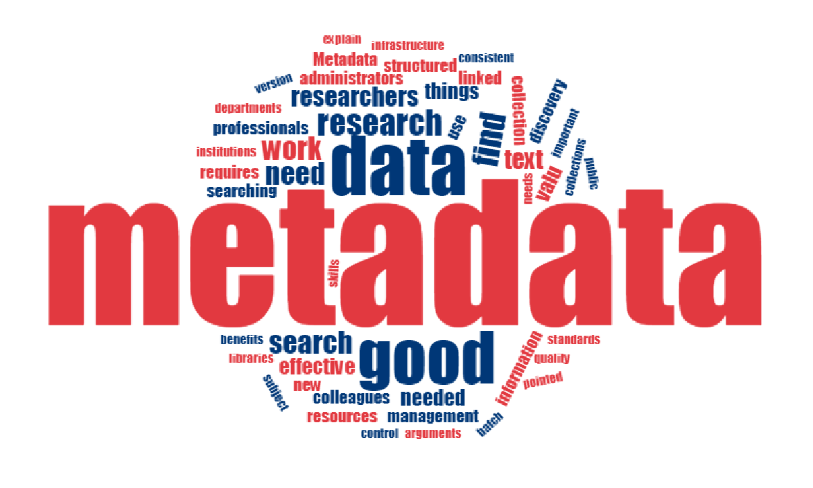
Visualize Publisher Metadata
for Easier Understanding and Management
Abeer A Albustanji Lana Kh Altarawneh
Diala M Alobisat Doaa M Almaitah
Supervisor
Dr.Hamzah Eyal Salman

Slide 2
Outlines
Introduction ( what and why )
Example of metadata
metadata types
Related Works
Methodology

Slide 3
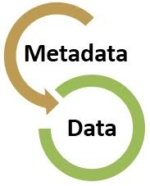
Introduction
What ?
Metadata : is the data about data. The metadata represent data that provides basic data about data and summarizes the basic parameters of the data

Slide 4
Introduction
a large number of heterogeneous and homogeneous data emerged.
The need to organize this data is based on an approach that :
Why ?
Quick, easy access to the data
The ease of retrieving data

Slide 5
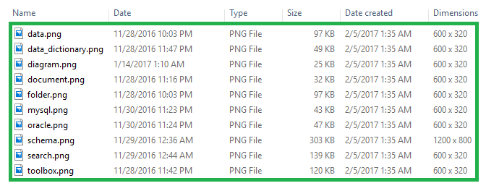
Example of metadata
Computer Files
Notes:
All the fields you see by each file in file explorer is actually metadata. The actual data is inside those files. Metadata includes:
file name, type, size, creation date and time, last modification date and time

Slide 6
Related Works:
Subject | Researcher / Year | Papers
The index is expected to archive all past and current reproduction exercises (counting information provenance) | (D, M., & Z, 2013) | depicts a way to deal with overseeing recreation information through the formation of a far-reaching metadata inventory.
an extended set of functionalities such as enabling annotation of images and text by integrating the Web Annotation Data Model | (A, R, Z, & A, 2018) | MetaStore, a metadata management framework for scientific data repositories.
running Map Reduce programs may complete without being killed by the Job Tracker due to quota policies | (G, S, & J, 2016) | reduce the metadata footprint in main memory by a factor of 42
OME Data Model is a metadata specification that supports the image data and metadata recorded. | (S, S, C, & M, 2016) | OMERO is an enterprise data management application that integrates image data

Slide 7
metadata types
Type | Definition | Examples
Administrative | Metadata used in managing and administering collections and information resources | Acquisition information
Descriptive | Metadata used to identify and describe collections and related information resources | Differentiations between versions
Preservation | Metadata related to the preservation management of collections and information resources | Documentation of physical condition of resources
Technical | Metadata related to how a system functions or metadata behaves | Hardware and software documentation

Slide 8
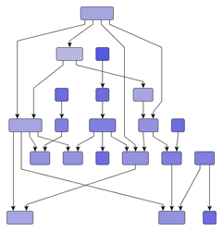
Methodology
Representing the metadata through a hierarchical graph
store and represent the relationship between data in any system as most systems doing in current time.

Slide 9
Methodology
depending on the data that submitted from the author the graph was building.
These data are considered as metadata for the publishing database of all its intellectual works.

Slide 10
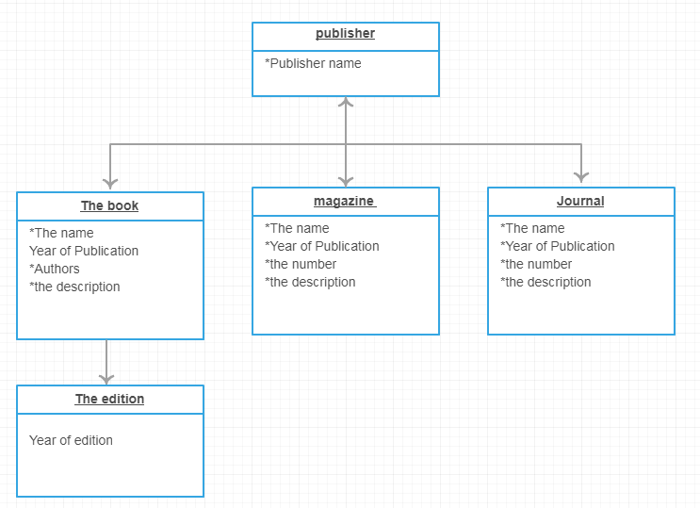
cont …
In the figure below an example of our proposed method:
Figure1: An example to represent metadata of publisher
Notes:
the publisher is the parent of the graph which has the publisher name as a public attribute which inherited to all his intellectual works.
the edge between the parent and the levels down represented the inheritance between the node in the second level.
The second level represents all intellectual works which published which has the name, the description of the book, the authors and year of publication as the public attributes of all node in this level.
All levels down represents the edition of the intellectual works were published which has the publication year as a private attribute.

Slide 11
References
A, P., R, S., Z, S., & A, H. (2018). MetaStore: an adaptive metadata management framework for heterogeneous metadata models. Distributed and Parallel Databases, pp. 153-194.
businessdictionary. (n.d.). businessdictionary. Retrieved from http://www.businessdictionary.com/definition/metadata.html
D, C., M., S., & Z, P. (2013). From big data to big data mining: challenges, issues, and opportunities. In International Conference on Database Systems for Advanced Applications ‏. Springer, pp. 1-15.
G, M., S, S., & J, W. (2016). Improving metadata management for small files in HDFS. IEEE International Conference, (pp. 1-4).
L, P., D, L., & A, C. (2017). The ground truth about metadata and community detection in networks. Science advances.
M, F., & L, F. (2018). Metadata. In Modern Data Strategy. Springe.
marciazeng. (2008). Retrieved from http://marciazeng.slis.kent.edu
Nae, S., Hwajung Kim, Y., Han, H., & Heon . (2018). Optimizing of metadata management in large-scale file systems. Cluster Computing, 1-15.
S, L., S, B., C, B., & M, C. (2016). Metadata management for high content screening in OMERO. pp. 27-32.

