Slide 1
Intelligent Transportation Systems
Presented By
Prof. Omer Maaitah
Mutah University

Slide 2
Outline
Intelligent Transportation Systems
ITS Applications
  Telematics
  = Telecommunication + Infomatics
ITS Standard Organization
Vehicular communication
Telecom Service Integration

Slide 3
Outline
Intelligent Transportation Systems
ITS Applications
  Telematics
  = Telecommunication + Infomatics
ITS Standard Organization
Vehicular communication
Telecom Service Integration

Slide 4
Intelligent Transportation System
The term intelligent transportation system (ITS) refers to efforts to add information and communications technology to transport infrastructure and vehicles, in order to improve safety and reduce vehicle wear, transportation times, and fuel consumption.

Slide 5
Intelligent Transport Systems
ITS are advanced applications which, without embodying intelligence as such, aim to provide innovative services relating to different modes of transport and traffic management and enable various users to be better informed and make safer, more coordinated, and 'smarter' use of transport networks.
Interest in ITS comes from the problems caused by traffic congestion and a synergy of new information technology for simulation, real-time control, and communications networks. Traffic congestion has been increasing worldwide as a result of increased motorization, urbanization, population growth, and changes in population density. Congestion reduces efficiency of transportation and increases travel time, air pollution, and fuel consumption

Slide 6
Intelligent transport technologies
Intelligent transport systems vary in technologies applied, from basic management systems such as car navigation; traffic signal control systems; container management systems; variable message signs; automatic number plate recognition or speed cameras to monitor applications, such as security CCTV systems; and to more advanced applications that integrate live data and feedback from a number of other sources, such as parking guidance and information systems; weather information; bridge deicing systems; and the like. Additionally, predictive techniques are being developed to allow advanced modeling and comparison with historical baseline data. Some of these technologies are described in the following sections.

Slide 7
Technologie of ITS
I==Wireless communications:
Various forms of wireless communications technologies have been proposed for intelligent transportation systems.
2===Computational technologies:
Recent advances in vehicle electronics have led to a move toward fewer, more capable computer processors on a vehicle. A typical vehicle in the early 2000s would have between 20 and 100 individual networked microcontroller/Programmable logic controller modules with non-real-time operating systems
3=== Floating car data/floating cellular data:
"Floating car" or "probe" data collection is a set of relatively low-cost methods for obtaining travel time and speed data for vehicles traveling along streets, highways, freeways, and other transportation routes. Broadly speaking, three methods have been used to obtain the raw data:

Slide 8
4==Triangulation Method: In developed countries a high proportion of cars contain one or more mobile phones. The phones periodically transmit their presence information to the mobile phone network, even when no voice connection is established
5==Vehicle Re-Identification: Vehicle re-identification methods require sets of detectors mounted along the road. In this technique, a unique serial number for a device in the vehicle is detected at one location and then detected again (re-identified) further down the road
6===GPS Based Methods: An increasing number of vehicles are equipped with in-vehicle GPS (satellite navigation) systems that have two-way communication with a traffic data provider. Position readings from these vehicles are used to compute vehicle speeds

Slide 9
7== Sensing technologies :
Technological advances in telecommunications and information technology, coupled with state-of-the-art microchip, RFID (Radio Frequency Identification), and inexpensive intelligent beaconsensing technologies, have enhanced the technical capabilities that will facilitate motorist safety benefits for intelligent transportation systems globally.
8== Bluetooth detection:
Bluetooth is an accurate and inexpensive way to measure travel time and make origin/destination analysis. Bluetooth is a wireless standard used to communicate between electronic devices like mobile/smart phones, headsets, navigation systems, computers etc.

Slide 10
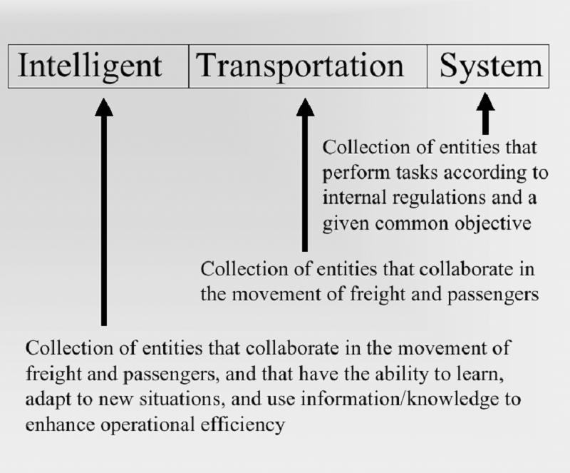

Slide 11
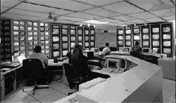
Introduction of ITS
Air-line Information
ITS is...
Traffic Information
Bus Information
...Traffic and Transit Management

Slide 12

Introduction of ITS
ITS is...
Traffic light control
...Traffic Signal Systems

Slide 13
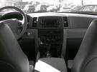

Introduction of ITS
ITS is...
Locate car’s current position by satellites
...Global Positioning Systems

Slide 14
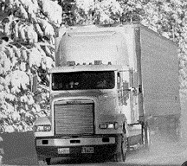
Introduction of ITS
ITS is...
• Weather
Information
Systems
• Commercial
Vehicle
Electronic
Clearance
Vehicle Electronic Clearance

Slide 15
Introduction of ITS
freeway Information
ITS is...
Navigation Information
Bus-stop Information
...Real-Time Traveler Information

Slide 16
Why is ITS Important?
• Offers the next major leap forward in
improving safety, convenience, and
productivity of our personal and
commercial travel.
• Critical as population and congestion
increase, and land and funding for new
roads decrease.

Slide 17
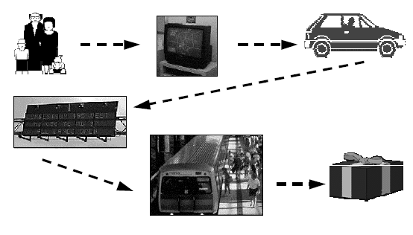
How Does ITS Touch YOU?

Slide 18
Identified Benefits
Time Savings
Improved Throughput
Reduced Crashes and Fatalities
Cost Avoidance
Increased Customer Satisfaction
Energy and Environmental Benefits

Slide 19
Outline
Intelligent Transportation Systems
ITS Applications
  Telematics
  = Telecommunication + Infomatics
ITS Standard Organization
Vehicular communication
Telecom Service Integration

Slide 20
Applications Overview
Global Positioning Systems
Weather information systems
Bus Information System
Traffic and transit management
Real-time information
Parking
Incident management
Emergency management
Electronic toll collection
Commercial vehicle operations

Slide 21
Global Positioning Systems
The Global Positioning System (GPS) is a satellite-based navigation system made up of a network of 24 satellites placed into orbit by the U.S. Department of Defense. GPS was originally intended for military applications, but in the 1980s, the government made the system available for civilian use. GPS works in any weather conditions, anywhere in the world, 24 hours a day.

Slide 22
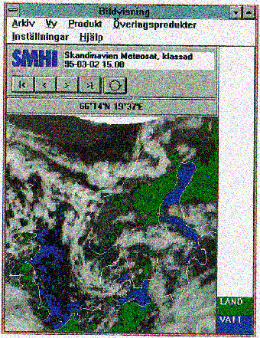
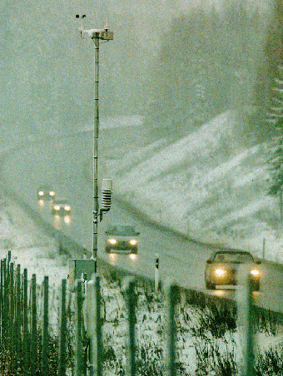
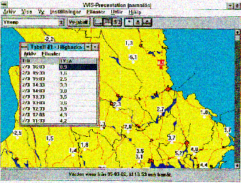
Weather information systems
Monitor the weather information
Notes:
22

Slide 23
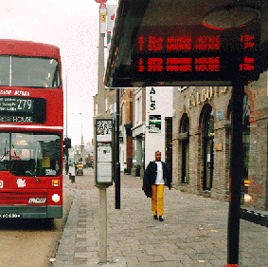
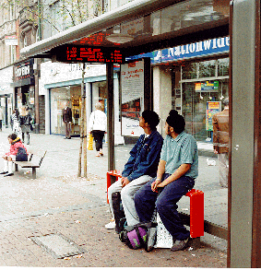
Bus Information System
Public Transport Information
  Countdown:
  Real-time Bus Stop Information (London, UK)
Notes:
23

Slide 24
Traffic and transit management
Traffic Signals
Monitoring throughput:
- Recommended speeds
- Ramp metering
Incident Management
Signal priority for:
- Emergency vehicles
- Public transport
Ramp metering

Slide 25
Real-time information
Automobile traffic
Public transport
Parking
Airport arrivals/departures
News, banking, stocks…

Slide 26
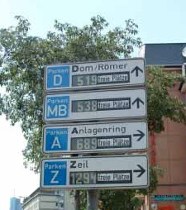
Parking
Information on
availability
Guidance to:
- Available facility
- Actual spot

Slide 27
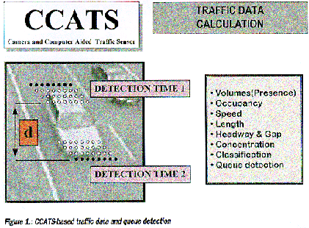
Incident management
CCATS & CCIDS: Video-Based Solutions for Data Collection and Incident Detection (Europe)
Notes:
27

Slide 28
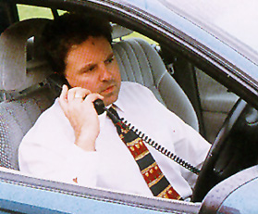
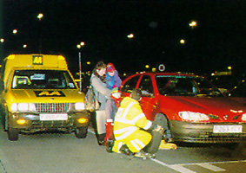
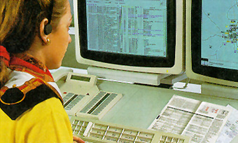
Emergency management
Pre-trip, On-trip, emergency
  AA ITS Service (UK)
  ADAC ITS Services (Germany)
Notes:
28

Slide 29
Electronic toll collection
Electronic toll collection (ETC) makes it possible for vehicles to drive through toll gates at traffic speed, reducing congestion at toll plazas and automating toll collection. Originally ETC systems were used to automate toll collection, but more recent innovations have used ETC to enforce congestion pricing through cordon zones in city centers and ETC lanes.
Notes:
The London congestion charge is a fee for some motorists travelling within those parts of London designated as the Congestion Charge Zone (CCZ). The main objectives of this charge are to reduce congestion, and to raise funds for investment in London's transport system. The zone came into operation in parts of Central London on 17 February 2003 and it was extended into parts of West London on 19 February 2007. Although not the first scheme of its kind in the United Kingdom, it was the largest when it was introduced, and it remains one of the largest in the world. Worldwide, several cities have referenced the London scheme when considering their own possible schemes. A payment of £8 is required for each day a chargeable vehicle enters or travels within the zone between 7am and 6pm; a fine of between £60 and £180 is imposed for non-payment.

Slide 30
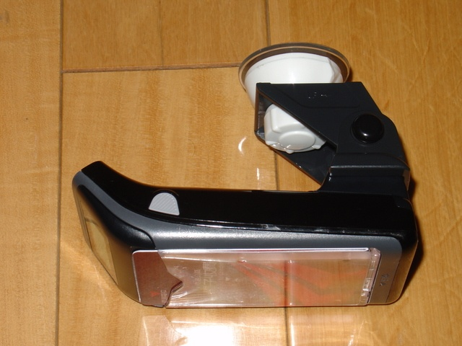
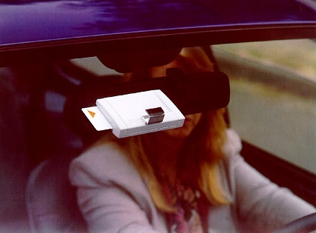
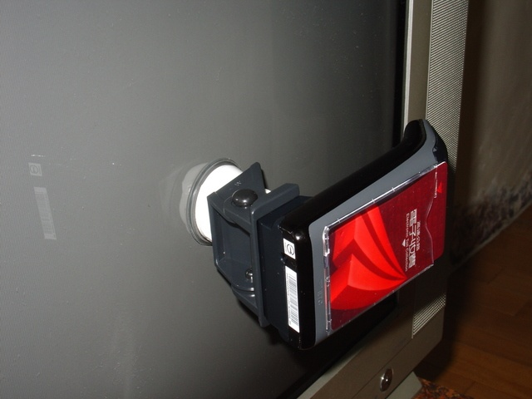
Electronic toll collection
Electronic Payment
  HAMLET 2 - Toll Collection on Motorways (France)
  ETC - Electronic toll collection (Taiwan)
Notes:
30

Slide 31

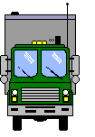
Commercial vehicle operations
Fleet Management
  Taxi
  Buses
  Vans and Lorries
  Emergency Vehicle
Security and Safety
  Tracking of Stolen Vehicle
  Tracing of emergency vehicle
  Tracking of Hazardous Goods
Notes:
31

Slide 32
Outline
Intelligent Transportation Systems
ITS Applications
  Telematics
  = Telecommunication + Infomatics
ITS Standard Organization
Vehicular communication
Telecom Service Integration

Slide 33
National ITS Architecture (US)
The National ITS Architecture provides a common framework for planning, defining, and integrating intelligent transportation systems. It is a mature product that reflects the contributions of a broad cross-section of the ITS community (transportation practitioners, systems engineers, system developers, technology specialists, consultants, etc.)

Slide 34
National ITS architecture defines …
The functions (e.g., gather traffic information or request a route) that are required for ITS
The physical entities or subsystems where these functions reside (e.g., the field or the vehicle)
The information flows and data flows that connect these functions and physical subsystems together into an integrated system

Slide 35
ITS standards activities
AASHTO (American Association of State Highway and Transportation Officials)
ANSI (American National Standards Institute)
APTA (American Public Transportation Association)
ASTM (American Society for Testing and Materials)
IEEE (Institute of Electrical and Electronics Engineers)
ITE (Institute of Transportation Engineers)
NEMA (National Electrical Manufacturers Association)
SAE (Society of Automotive Engineers)

Slide 36
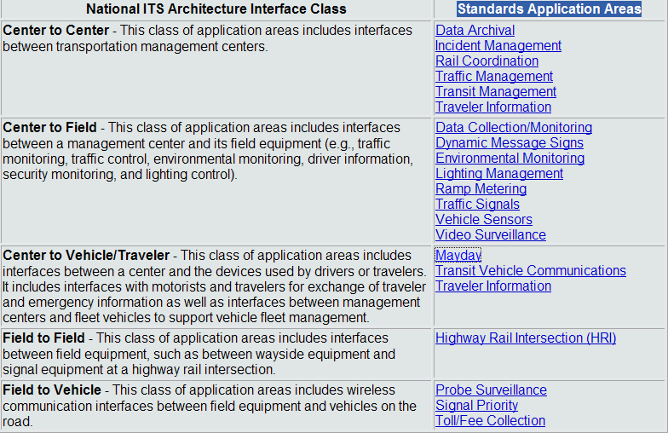
Applicable interfaces

Slide 37
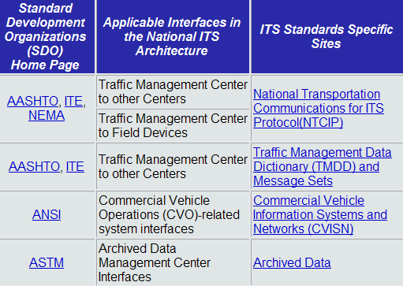
Picture from National ITS Architecture Website
Notes:
AASHTO, ITE, NEMA ( http://www.ntcip.org/ )
AASHTO, ITE ( http://www.ite.org/tmdd/ )
ANSI (http://cvisn.fmcsa.dot.gov/ )
ASTM ( http://www.fhwa.dot.gov/policy/ohpi/travel/adus.htm )
( reference site : http://www.iteris.com/itsarch/ )

Slide 38
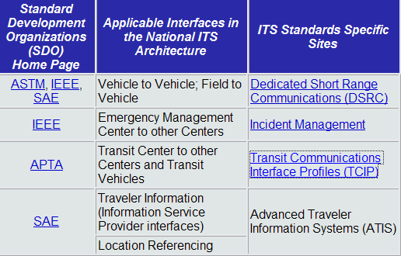
Picture from National ITS Architecture Website
Notes:
ASTM, IEEE, SAE ( http://www.leearmstrong.com/DSRC/DSRCHomeset.htm )
IEEE ( http://grouper.ieee.org/groups/scc32/imwg/index.html )
APTA ( http://www.aptastandards.com/APTAStandards/tabid/36/Default.aspx )
( reference site : http://www.iteris.com/itsarch/ )

Slide 39
Outline
Intelligent Transportation Systems
ITS Applications
  Telematics
  = Telecommunication + Infomatics
ITS Standard Organization
Vehicular communication
Telecom Service Integration

Slide 40
Motivation for Vehicular Communication (VC)
The main goal of VC is convenient and safe.
Vehicles have… (differs from personal comm.)
  Enough power
  Large space
  Predictable and high-speed mobility
Use communication for new services
  Collision warning
  Up-to-date traffic information
  Active navigation services
  Weather information

Slide 41
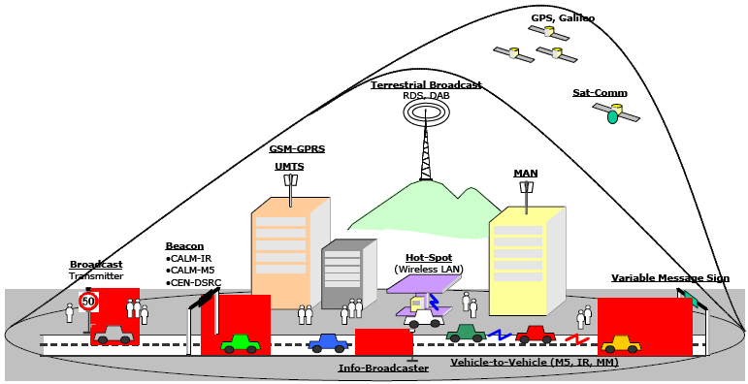
Vehicular Communication Technology
Inside car
  Bluetooth, Zigbee
Car to car
  VANET,802.11p
Car to road
  802.11p
Car to Internet
  3G, WiMAX
(current) CALM
(Continuous Air-interface,
Long and Medium range )

Slide 42
VANET
Vehicular ad hoc networks (VANETs), a subclass of
mobile Ad Hoc networks (MANETs), is a promising approach for future intelligent transportation system (ITS).
The direct communication between vehicles using an Ad Hoc network, referred to as
  inter-vehicle communication (IVC)
  Car-to-car communication(C2CC)
  vehicle ad hoc networks (VANETs)

Slide 43
IEEE 802.11p
IEEE 802.11p is a draft amendment to the IEEE 802.11 standard to add wireless access in the vehicular environment (WAVE). It defines enhancements to 802.11 required to support Intelligent Transportation Systems (ITS) applications. This includes data exchange between high-speed vehicles and between the vehicles and the roadside infrastructure in the licensed ITS band of 5.9 GHz (5.85-5.925 GHz). IEEE 1609 is a higher layer standard on which IEEE 802.11p is based.
http://en.wikipedia.org/wiki/IEEE_802.11p
Notes:
802.11p…
Provision of externally-driven services to vehicles has been limited because of the lack of ubiquitous high-speed communications between vehicles and service providers, and the lack of homogeneous communications interfaces between different automotive manufacturers. The IEEE 1609 Family of Standards for Wireless Access in Vehicular Environments (WAVE) completely address the latter issue, and provide a sufficient foundation regarding the organization of management functions and modes of operation of system devices to address the former.
( reference http://www.standards.its.dot.gov/fact_sheet.asp?f=80 )

Slide 44
3G/UMTS
Universal Mobile Telecommunications System (UMTS) is one of the emerging mobile phone technologies known as third-generation, or 3G. Third-generation systems are designed to include such traditional phone tasks as calls, voice mail, and paging, but also new technology tasks such as Internet access, video, and SMS, or text messaging.
http://en.wikipedia.org/wiki/Universal_Mobile_Telecommunications_System

Slide 45
WiMAX
WiMAX, the Worldwide Interoperability for Microwave Access, is a telecommunications technology that provides for the wireless transmission of data in a variety of ways, ranging from point-to-point links to full mobile cellular-type access. The technology provides broadband speed without the requirement of cables. The technology is based on the IEEE 802.16 standard (also called WirelessMAN)
http://en.wikipedia.org/wiki/Wimax

Slide 46
Outline
Intelligent Transportation Systems
ITS Applications
  Telematics
  = Telecommunication + Infomatics
ITS Standard Organization
Vehicular communication
Telecom Service Integration

Slide 47
VC Service Integration

Slide 48
VC Service scenario

Slide 49
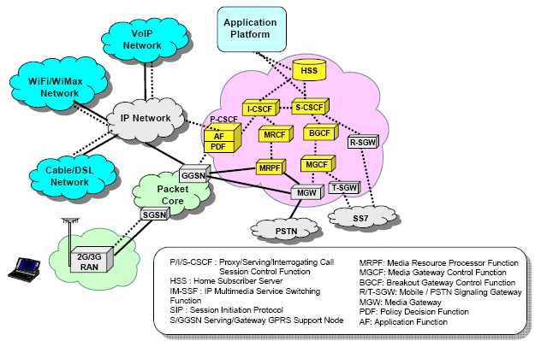
IP Multimedia Subsystem (IMS)

