Slide 1
Rural Transit Stop Design Guidelines
Presented By
Prof. Omer Maaitah
Mutah University

Slide 2
Why are Bus Stops Important?
Key element in the overall experience provided to transit passengers, as they are used by all fixed-route passengers as part of every trip
Ensure access by persons with disabilities
Allow for effective transit operations
A vital part of a transit program’s public image
Properly designed, bus stops can be an attractive part of a neighborhood and minimize the impacts of transit passengers on adjacent properties

Slide 3
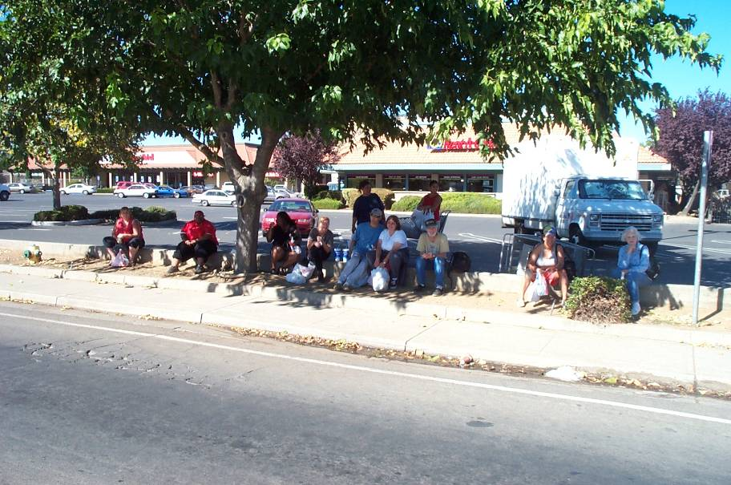

Slide 5
Bus Stop Design Standards
Recommended design standards are based
on the following:
Local conditions, particularly reflecting rural character
The desire to provide attractive, safe, and functional facilities

Slide 6
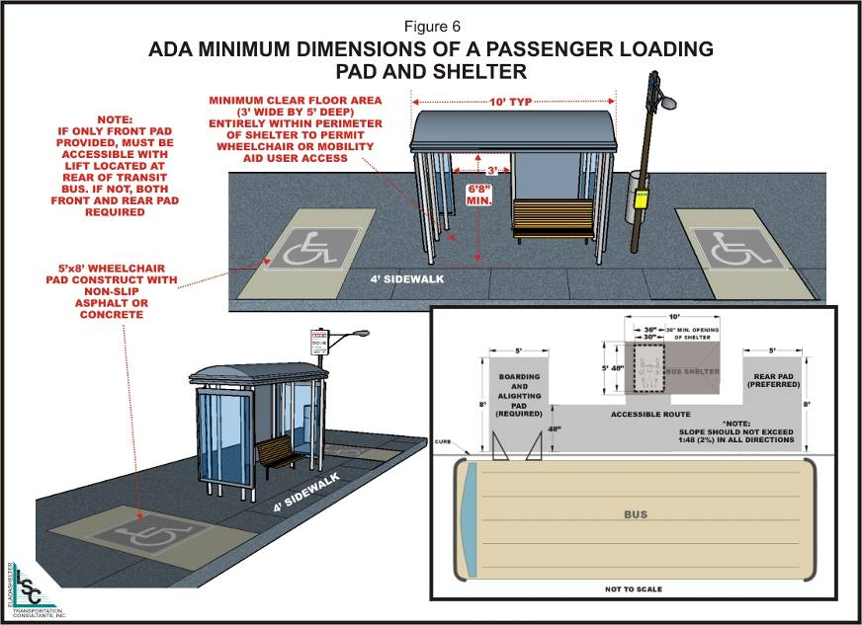

Slide 7
Wheelchair Accessibility in Rural Areas
As it is not feasible to provide a full wheelchair pad at all rural stops, transit operators often use driveways or low-volume cross streets as informal pads
A paved surface is necessary
Grades should be no more than 2 percent in any direction
Prior permission of landowner or local jurisdiction (authority) is encouraged
Adequate driver sight distance needs to be provided

Slide 8
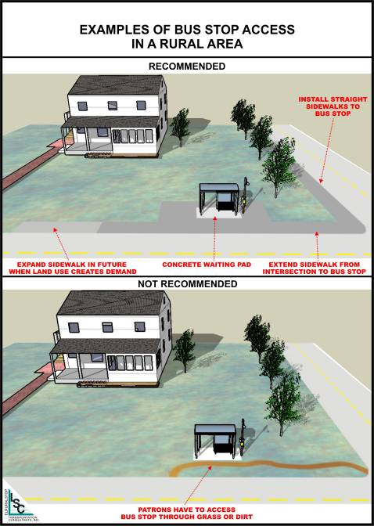

Slide 9
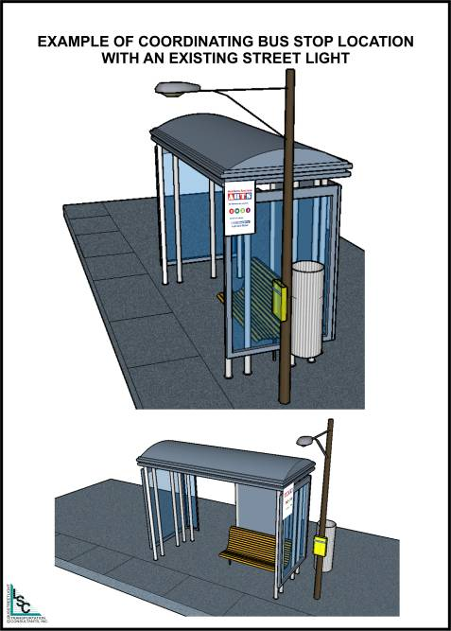

Slide 11
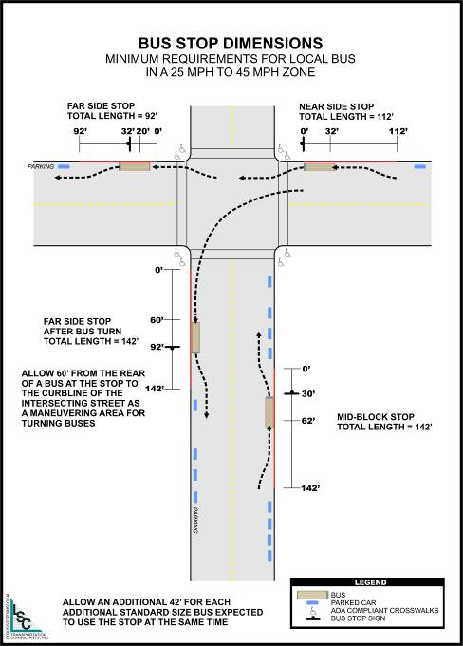

Slide 12
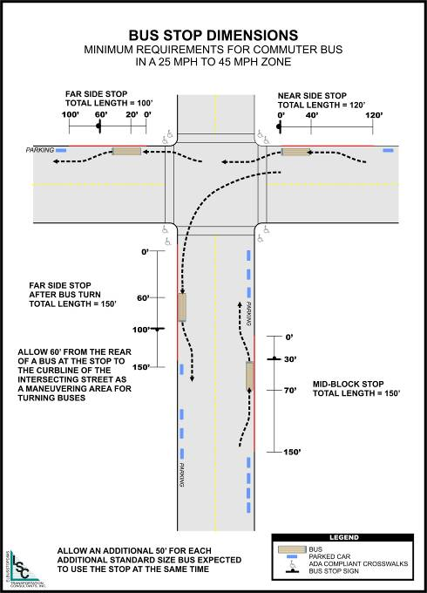

Slide 13
Where Are Transit Stops Not Appropriate?
Where provision (rider) of the stop would generate pedestrian crossing activity that places pedestrians at significant risk.
  Passenger traffic generator on opposite side of the roadway (such as commercial center or high density residential area)
  High traffic speeds (such as 40 mph or higher)
  Multilane roadway (4 or more lanes)
  Substantial traffic volumes (such as 20,000 vehicles per day or more)
  Lack of gaps in traffic stream
  Driver sight distance issues
This may mean that some areas cannot be served, or that stops will not be as convenient as passenger’s desire. Transit service may have liability even if the stop was in place prior to a development that generates the crossing activity.

Slide 14
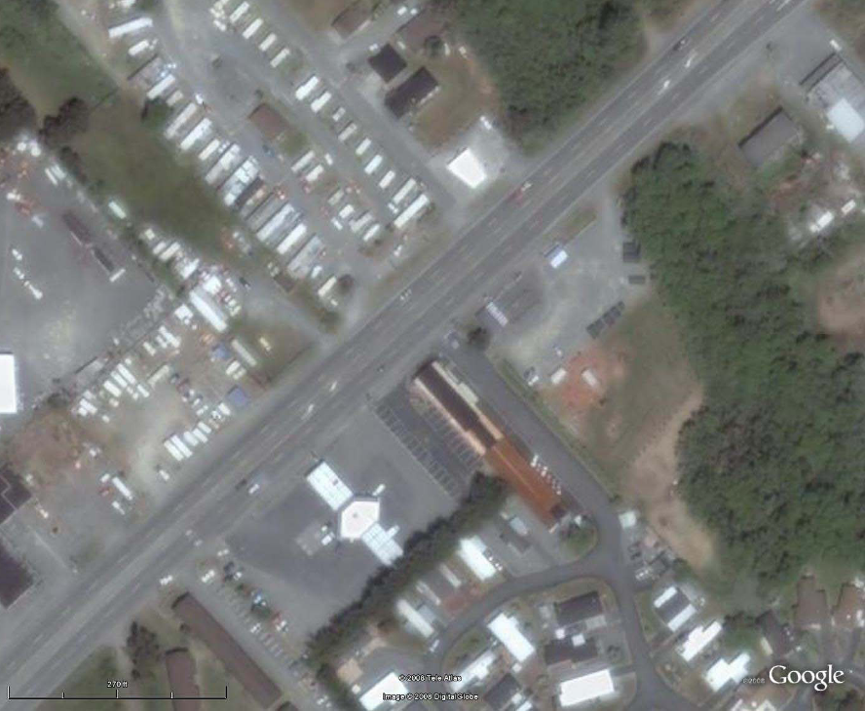

Slide 15
Rural Bus Pullout Location Factors
Roadway speed limit of 35 miles per hour or higher or
Daily traffic volume exceeding 5,000 for a two-lane roadway and 10,000 for a four-lane roadway or
Potential for conflicts between transit and passenger vehicles, such as driver sight distance issues or
High passenger activity

Slide 17
Transit Stop Amenities
Benches
Shelters
Signs
Trash receptacles
Lighting
Bicycle parking (lockers, cages, racks)
Phones

Slide 18
Sign, Bench, and Shelter Warrants
Sign: All Scheduled Stops
Bench: 5 to 9 boardings per day
Shelter with bench: 10 or more boardings per day, factored to consider the availability of existing shelter, number of elderly or disabled potential riders, and nearby land uses

Slide 19
Benefits of Preparing Transit Stop Guidelines
Provide transit improvement standards appropriate for the local services
Guide local governments, developers, etc. in providing useful, attractive, and safe transit facilities for the region’s transit patrons
Guide transit staff in reviewing and providing comments on development and roadway plans
While a transit agency cannot supersede the authority of the local jurisdictions, guidelines can offer criteria for the design of a more pedestrian-oriented and transit-friendly environment

Slide 20
Development Review Checklist
Can be used by transit staff or others to assess a project’s impact on transit services
Can identify issues that merit consideration in the approval process

Slide 21
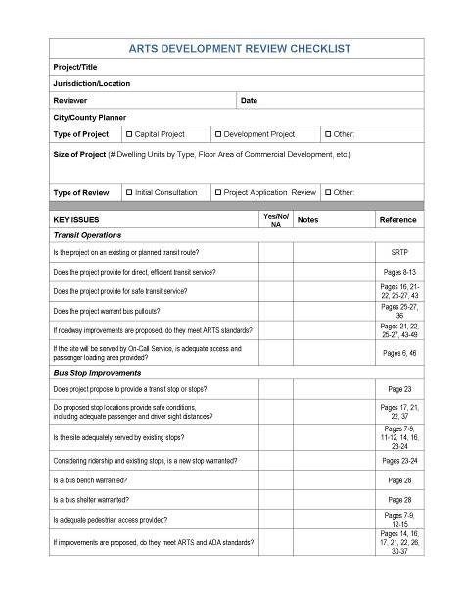
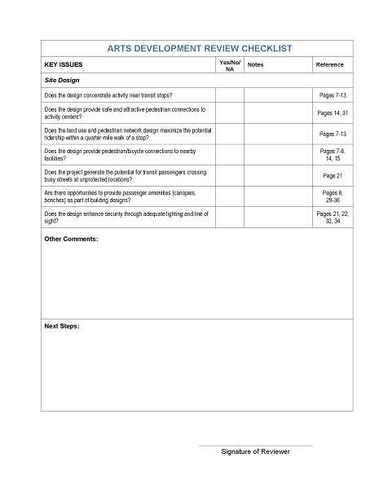

Slide 22
Using the Design Guidelines
An inventory of all stops is a useful step in ensuring that improvements make the best use of available funds, and in justifying funding.
This information presents minimum dimensions. Typically, additional space is beneficial and should be considered on a case-by-case basis.
Any facility design needs to consider the setting and expected use level. Given the variety of settings in which rural public transit services operate, facility designs need to be flexible.

