Slide 1
Lateral Earth Pressure and Retaining wall Design
Presented By
Prof. Omer Maaitah
Mutah University

Slide 2
Lateral Earth Pressure
Lateral earth pressure is a significant design element in a number of foundation engineering problems. Retaining and sheet-pile walls, both braced and unbraced excavations, grain in silo walls and bins, and earth or rock contacting tunnel walls and other underground structures require a quantitative estimate of the lateral pressure on a structural member for either a design or stability analysis.
The method of plastic equilibrium as defined by the Mohr rupture envelope is most generally used for estimating the lateral pressure from earth and other materials such as grain, coal, and ore. On occasion one may use the finite-element (of the elastic continuum) method but this has several distinct disadvantages for most routine design. The FEM has more application for estimating pressure on tunnel liners and large buried conduits than for most lateral pressure analyses.

Slide 3
Earth pressures are developed during soil displacements (or strains) but until the soil is on the verge of failure, as defined by the Mohr's rupture envelope (see Fig. 11-la), the stresses are indeterminate. They are also somewhat indeterminate at rupture since it is difficult to produce a plastic equilibrium state in a soil mass everywhere simultaneously—most times it is a progressive event. Nevertheless, it is common practice to analyze rupture as an ideal state occurrence, both for convenience and from limitations on obtaining the necessary soil parameters with a high degree of reliability.

Slide 4
TYPES OF EARTH-RETAINING STRUCTURES
Earth-retaining structures may be broadly classified as retaining walls and sheet pile walls.
Retaining walls may be further classified as:
(i) Gravity retaining walls —usually of masonry or mass concrete.
(ii) Cantilever walls
(iii) Counterfort walls usually of reinforced concrete.
(iv) Buttress walls
Sheet pile walls may be further classified as cantilever sheet pile walls and anchored sheet pile walls, also called ‘bulkheads’.

Slide 5
Gravity walls depend on their weight for stability; walls up to 2 m height are invariably of this type. The other types of retaining walls, as well as sheet-pile walls, are known as ‘flexible walls’. R.C. Cantilever walls have a vertical or inclined stem monolithic with a base slab. These are considered suitable up to a height of 7.5 m. A vertical or inclined stem is used in counterfort walls, supported by the base slab as well as by counterforts with which it is monolithic. Cantilever sheet pile walls are held in the ground by the passive resistance of the soil both in front of and behind them. Anchored sheet pile wall or bulkhead is fixed at its base as a cantilever wall but supported by tie-rods near the top, sometimes using two rows of ties and properly anchored to a dead man.

Slide 6
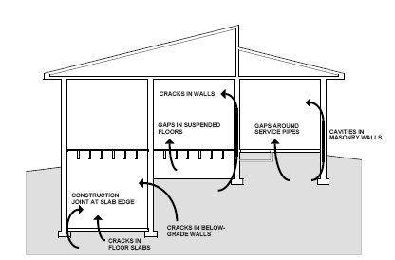

Slide 12


Slide 15
Active earth pressure

Slide 26
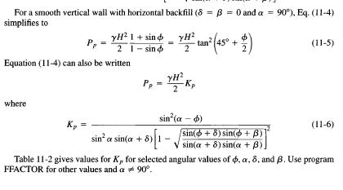

Slide 27
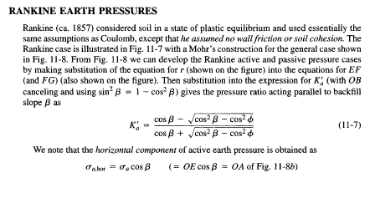

Slide 33
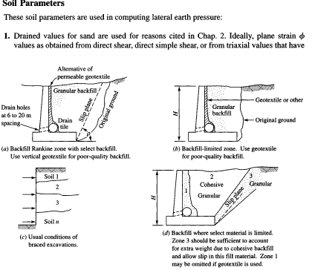

Slide 43
