Slide 1
Slope stability
Presented By
Prof. Omer Maaitah
Mutah University

Slide 2


Slide 7
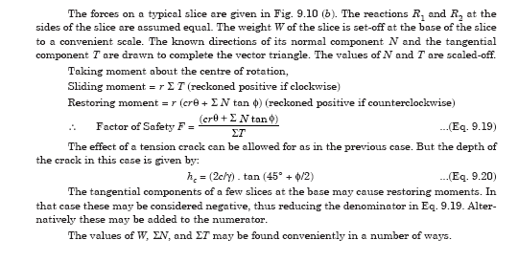

Slide 9
