Slide 1
Network Reference Models
Presented By
Dr. Waleed Alseat
Mutah University

Slide 2
Reference Models

Slide 3
Reference Models
a framework (guideline) for network implementation and troubleshooting
divides complex functions into simpler components
Importance of reference model:
Vendor interoperability “standardization”.
Better understanding of data transfer
Reference model types :
OSI (Open System Interconnection ).
TCP/IP (DOD Model).
Other Models.

Slide 4
Reference Models

Slide 5
Reference Models

Slide 6
Network media

Slide 7
Reference Models

Slide 8
Reference Models

Slide 9
Reference Models

Slide 10
Reference Models

Slide 11
Reference Models

Slide 12
Reference Models

Slide 13
Reference Models

Slide 14
Reference Models

Slide 15
Reference Models

Slide 16
Reference Models

Slide 17
Reference Models

Slide 18
Reference Models

Slide 19
Reference Models

Slide 20
Reference Models

Slide 21
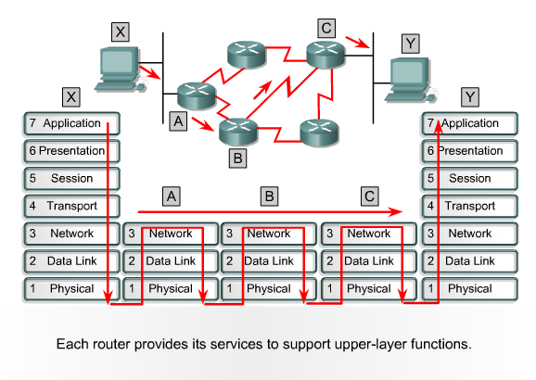
Transmission Example

