Slide 1
Application Layer Functionality and Protocols
Presented By
Dr. Waleed Alseat
Mutah University

Slide 2
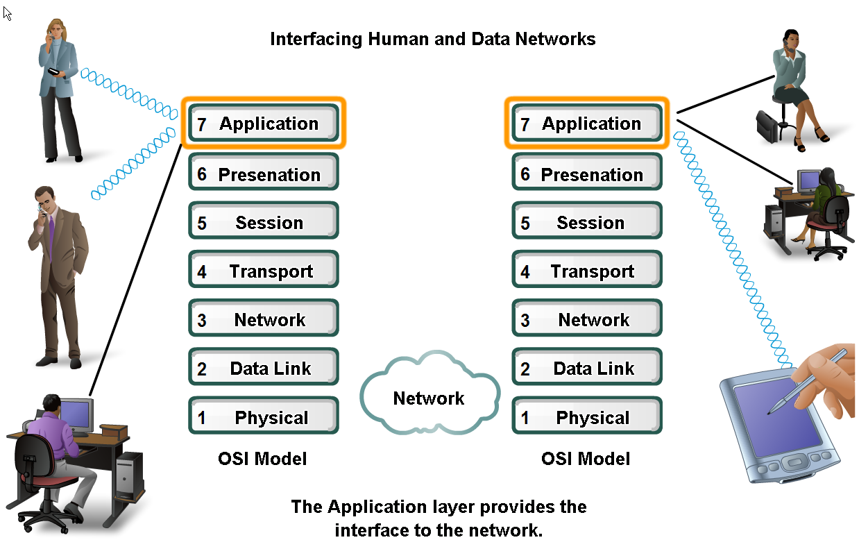
Applications
The Interface Between Human and Data Networks

Slide 3
Applications

Slide 4
Applications

Slide 5
Applications

Slide 6
Applications

Slide 7
Applications

Slide 8
Applications

Slide 9
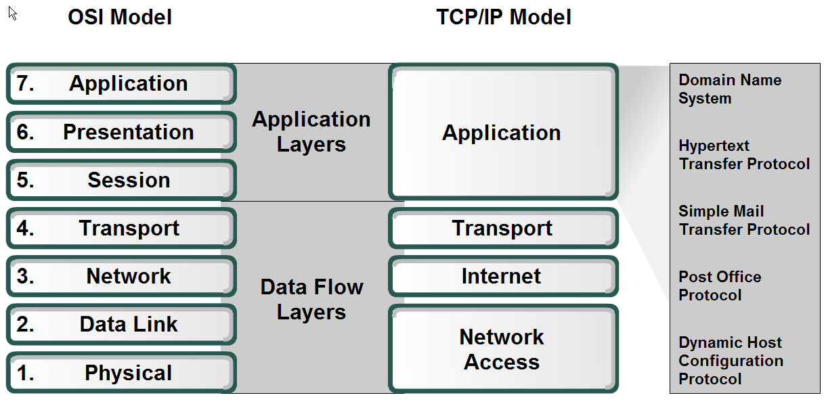
Applications

Slide 10
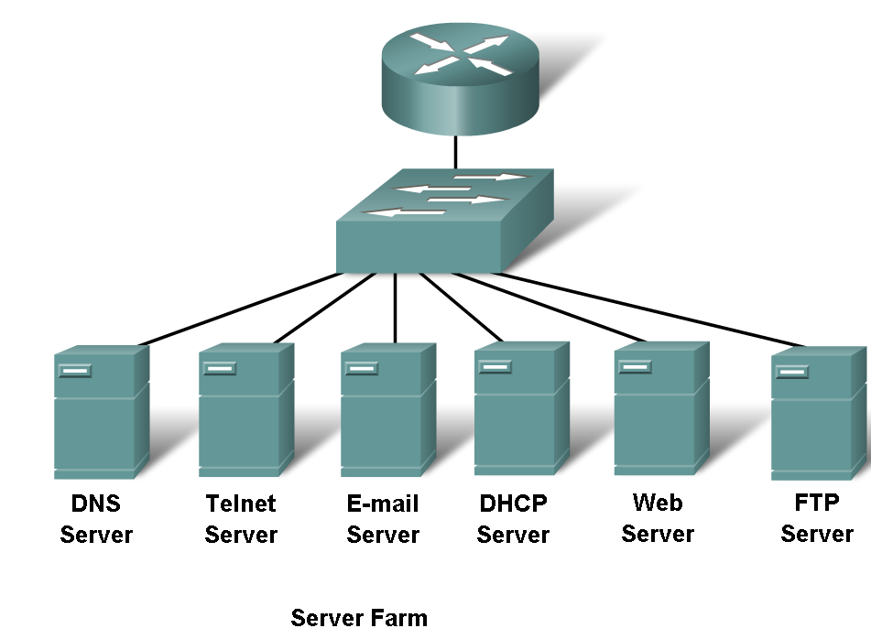
Server Farm

Slide 11
Server Farm

Slide 12
Server Farm

Slide 13
Server Farm

Slide 14
Server Farm

Slide 15
Server Farm

Slide 16
Server Farm

Slide 17
Client/Server Model

Slide 18
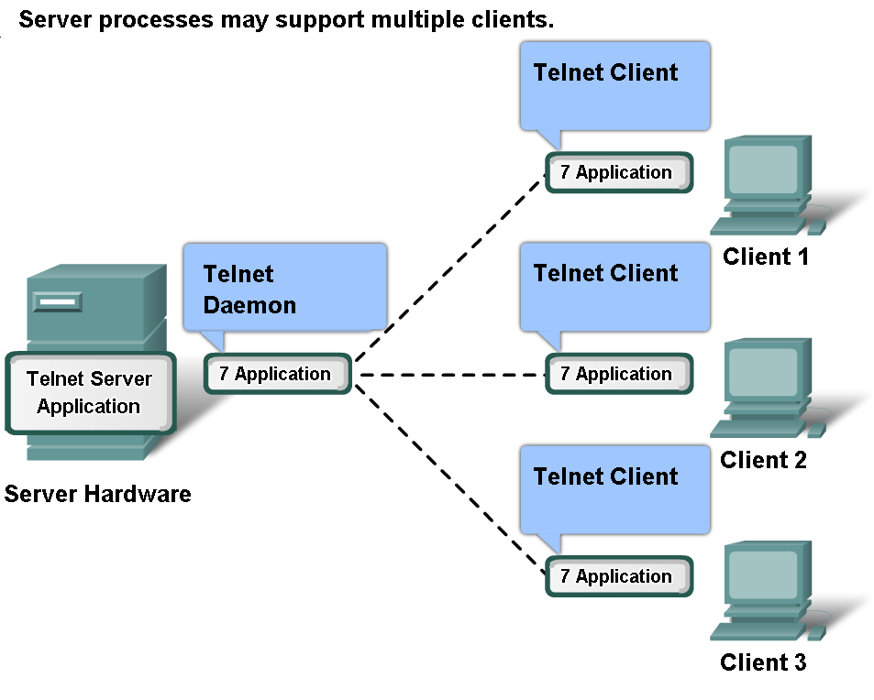
Client/Server Model

Slide 19
Peer to Peer Applications

Slide 20
Domain Name Server DNS

Slide 21
Domain Name Server DNS

Slide 22
Domain Name Server DNS

Slide 23
Domain Name Server DNS

Slide 24
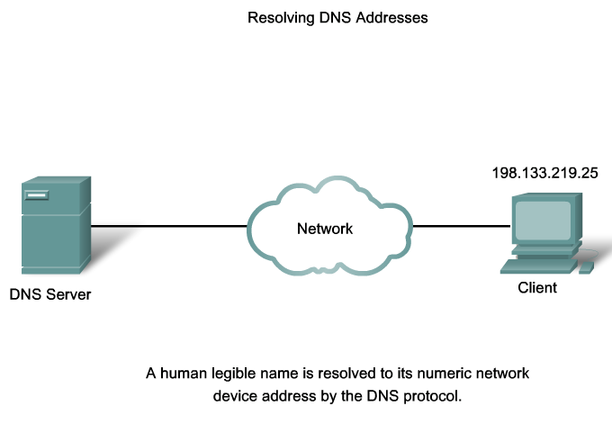
Domain Name Server DNS

Slide 25
Domain Name Server DNS

Slide 26
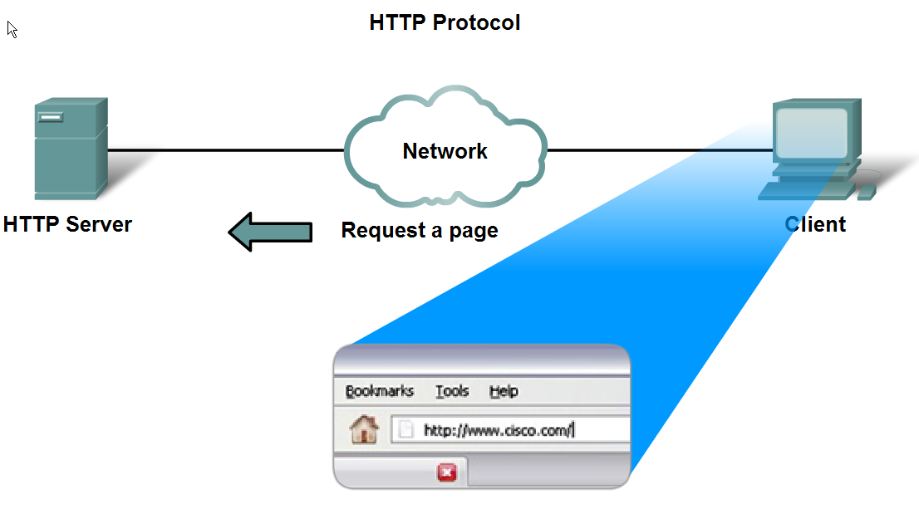
HyperText Transfere Protocol HTTP

Slide 27
HyperText Transfere Protocol HTTP

Slide 28
HyperText Transfere Protocol HTTP

Slide 29
Post Office Protocol POP / Simple Mail Transfer Protocol SMTP

Slide 30
Post Office Protocol POP / Simple Mail Transfer Protocol SMTP

Slide 31
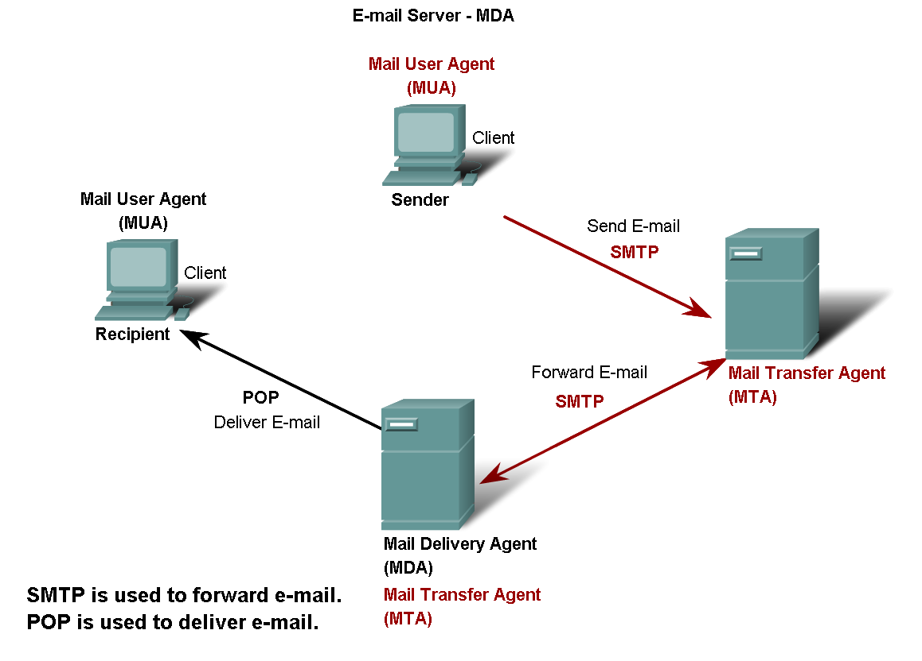
Post Office Protocol POP / Simple Mail Transfer Protocol SMTP

Slide 32
File Transfer Protocol FTP

Slide 33
Dynamic Host Configuration Protocol DHCP

Slide 34
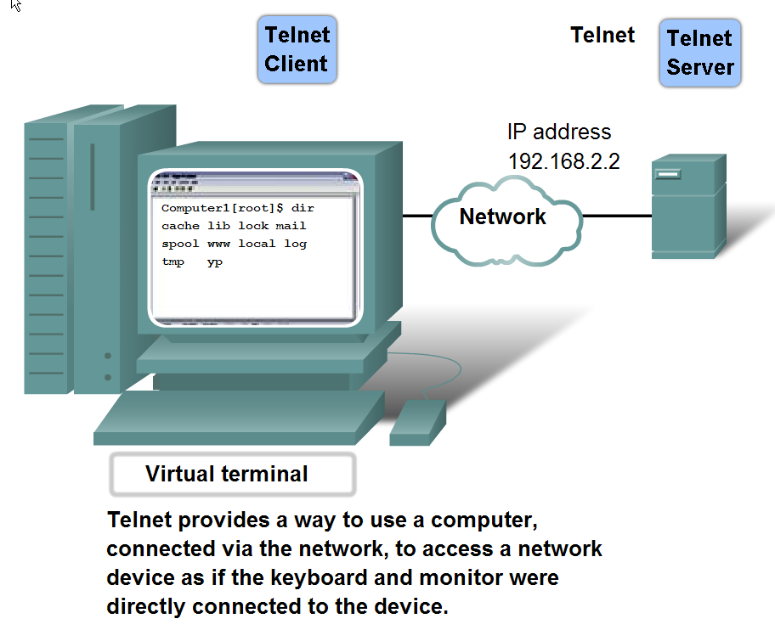
Telecommunication Network Telnet
Notes:
34

Slide 35
Peer-To-Peer Application P2P

Slide 36
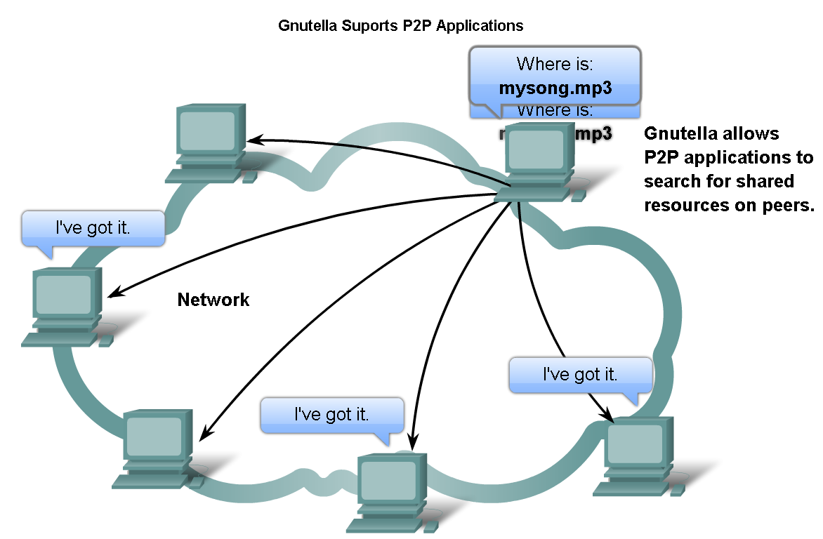
Features, Operation, and Use of TCP/IP Application Layer Services
Describe the features of the Gnutella protocol and the role it plays in supporting P2P services

