Slide 1
OSI Data Link Layer
Presented By
Dr. Waleed Alseat
Mutah University

Slide 3
Objectives
Explain the role of Data Link layer protocols in data transmission.
Describe how the Data Link layer prepares data for transmission on network media.
Describe the different types of media access control methods.
Identify several common logical network topologies and describe how the logical topology determines the media access control method for that network.
Explain the purpose of encapsulating packets into frames to facilitate media access.
Describe the Layer 2 frame structure and identify generic fields.
Explain the role of key frame header and trailer fields including addressing, QoS, type of protocol and Frame Check Sequence.

Slide 4
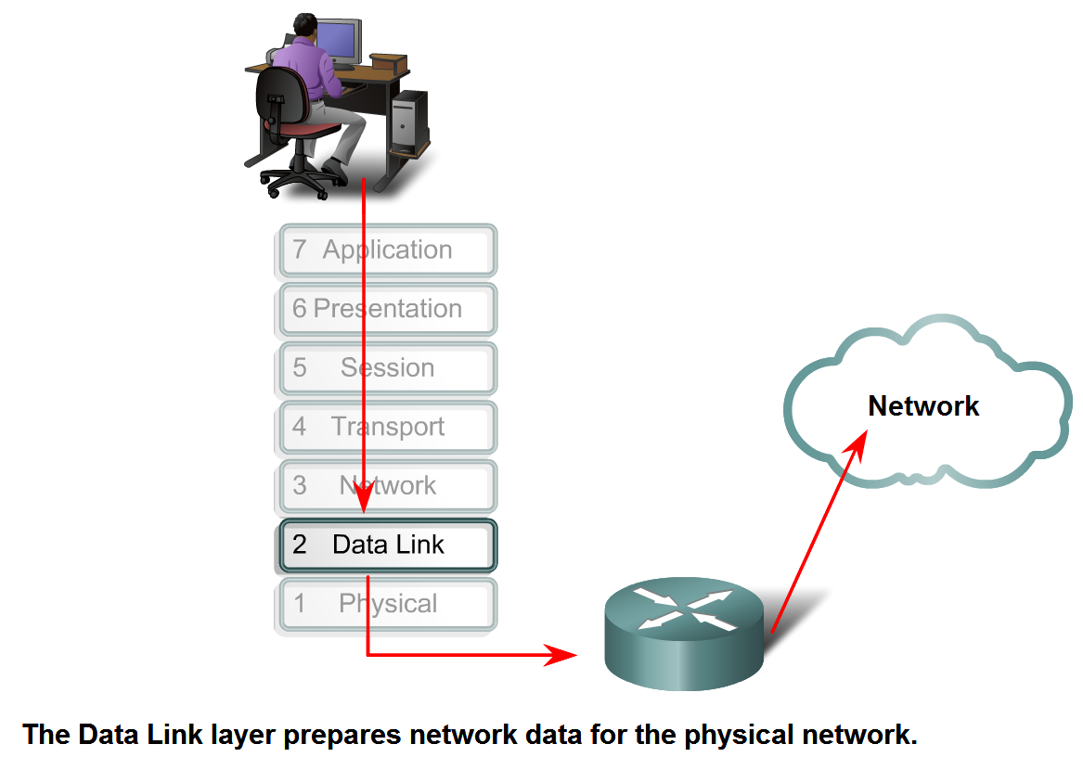
Data Link Layer – Accessing the Media

Slide 5
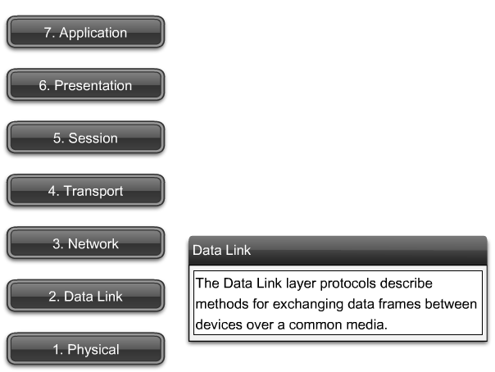
Data Link Layer – Accessing the Media

Slide 6
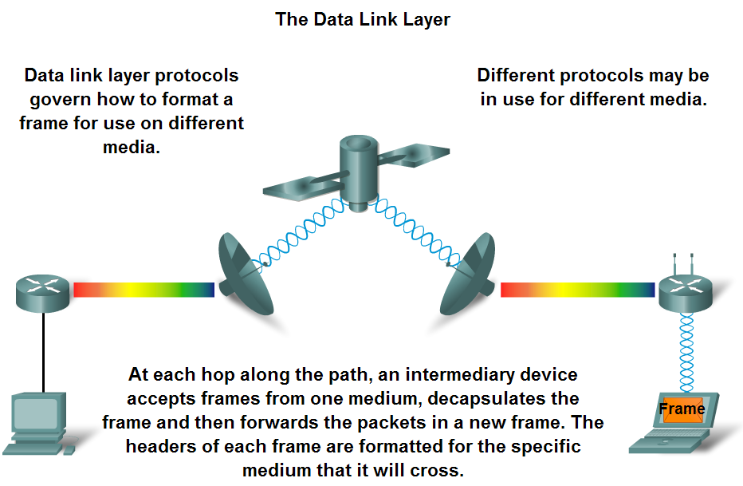
Data Link Layer – Accessing the Media

Slide 7
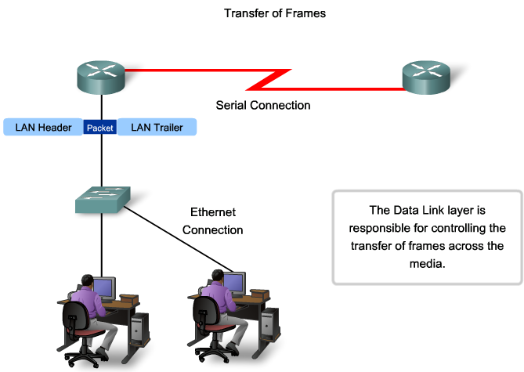
Data Link Layer – Accessing the Media

Slide 8
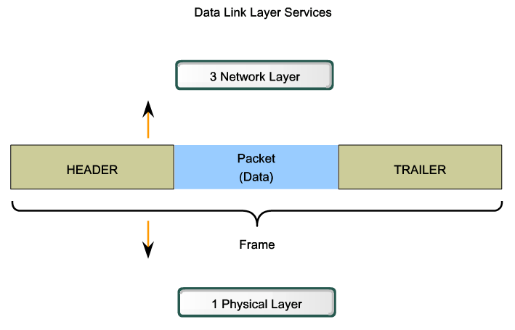
Data Link Layer – Accessing the Media

Slide 9
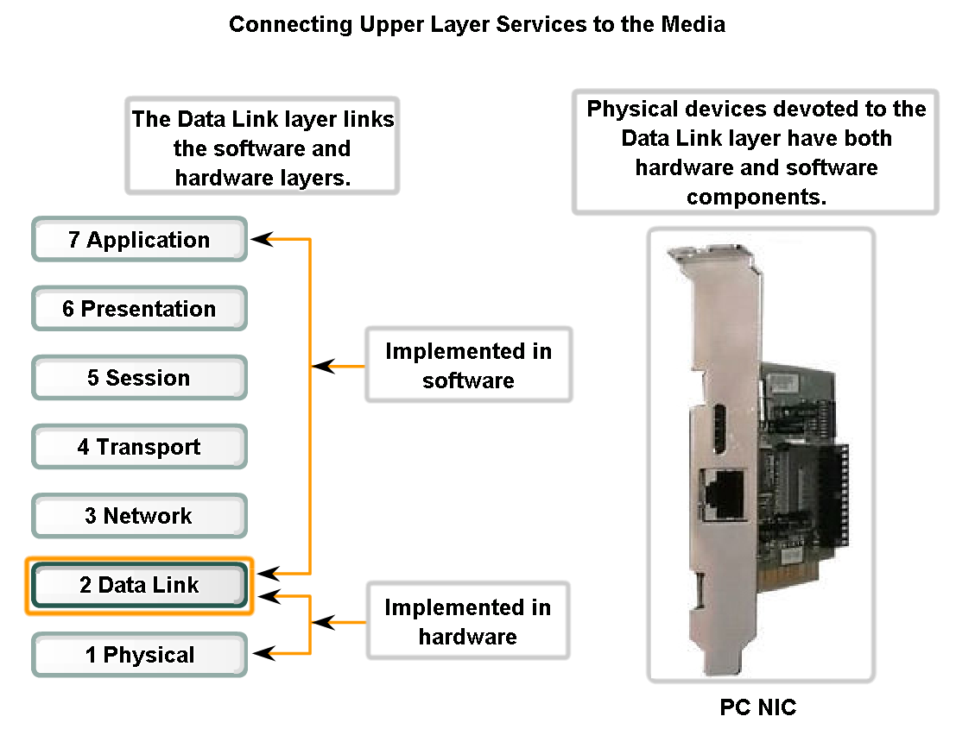
Data Link Layer – Accessing the Media

Slide 10
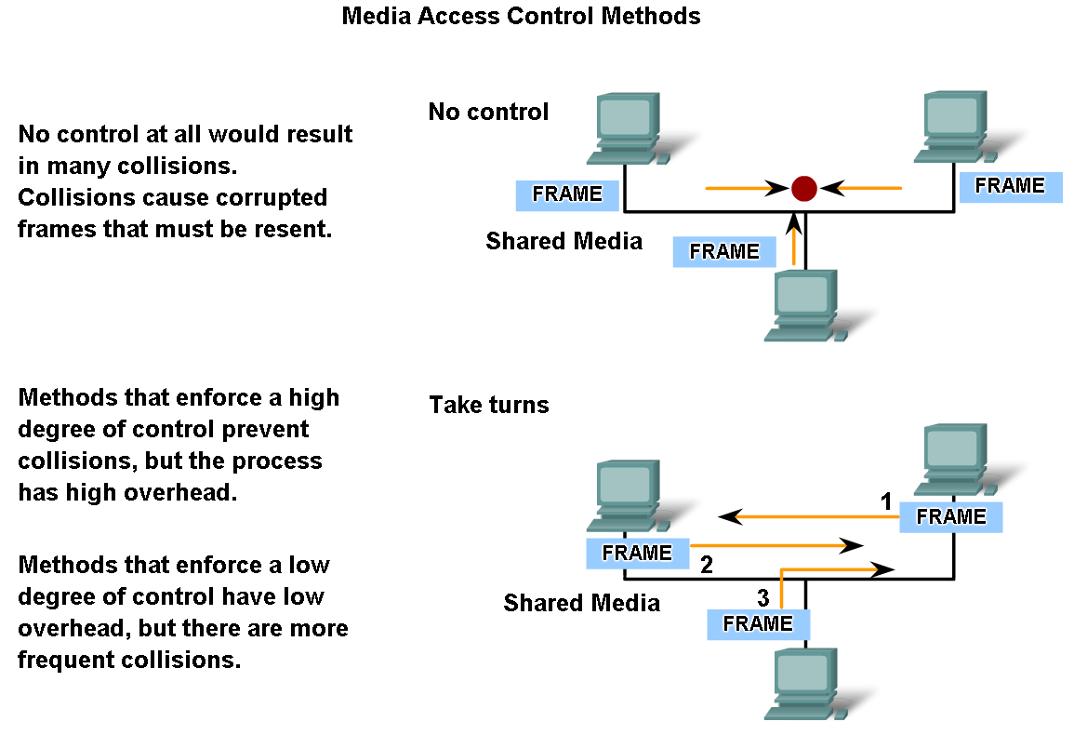
Media Access Control Techniques

Slide 11
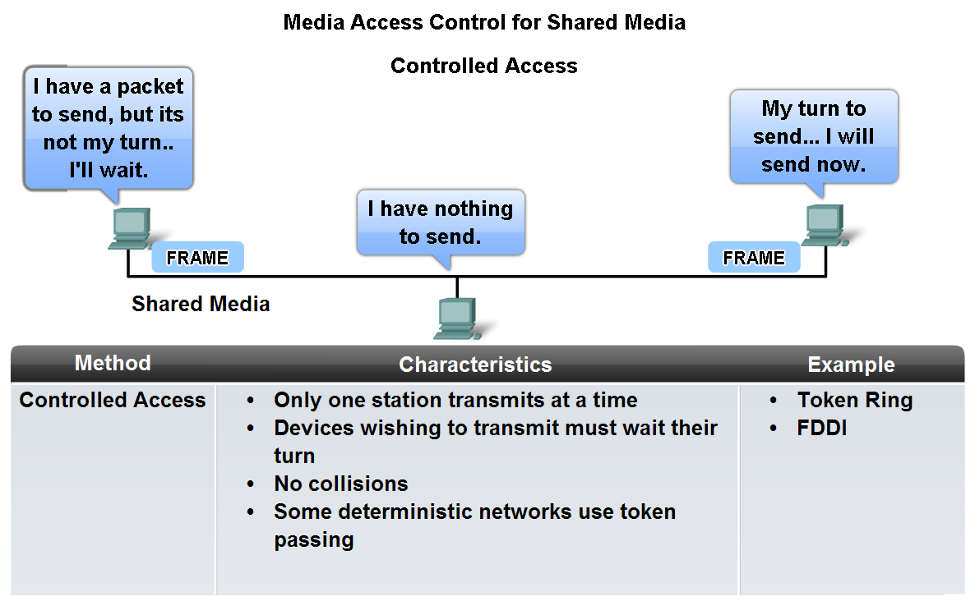
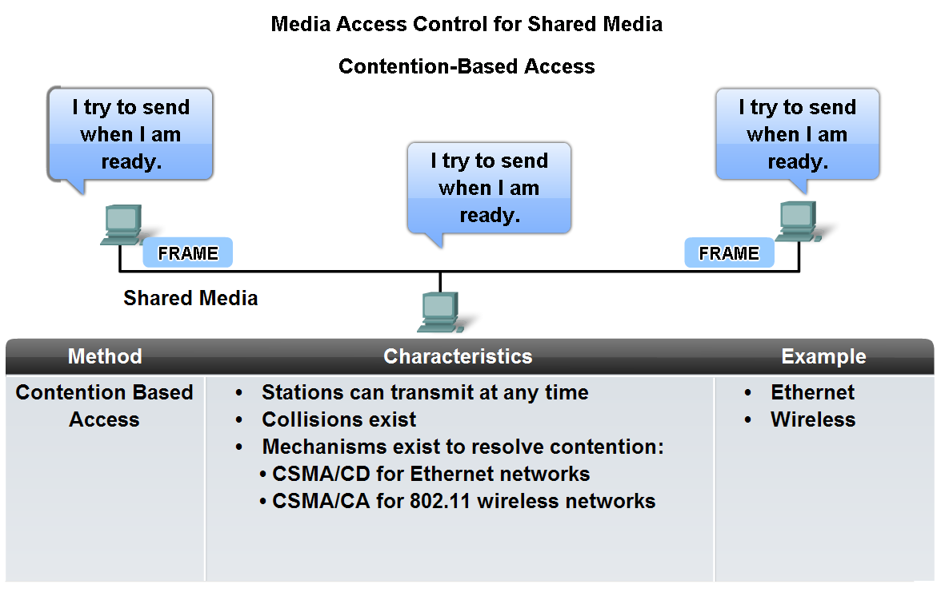
Media Access Control Techniques

Slide 12
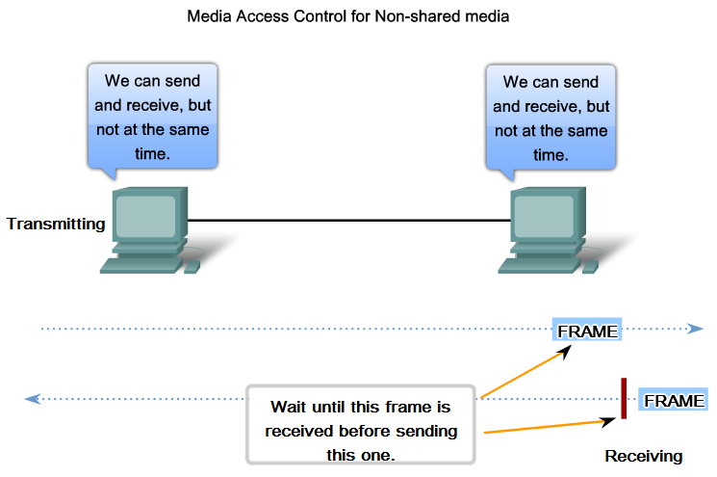
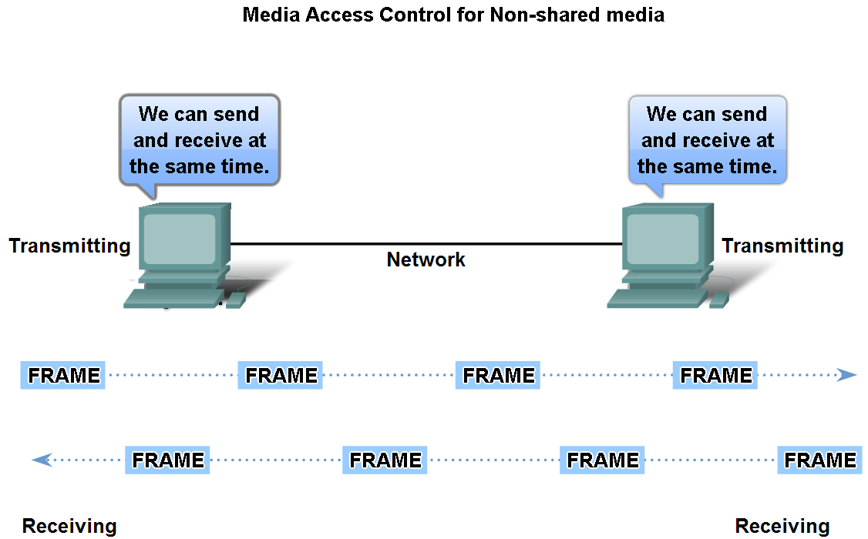
Media Access Control Techniques
Define Full Duplex and Half Duplex as it relates to Media Access Control for non-shared media
Half Duplex
Full Duplex

Slide 13
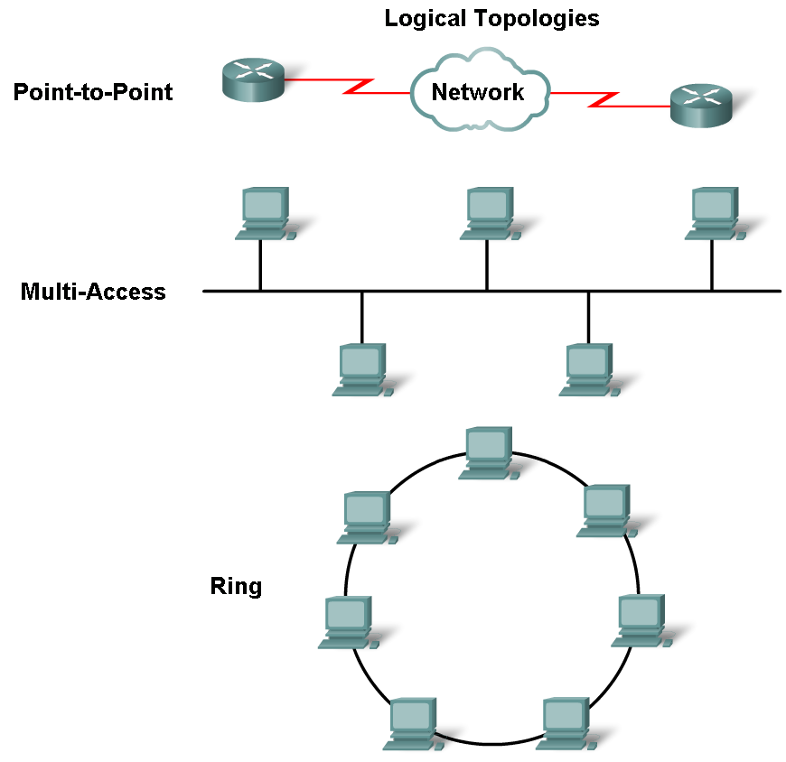
Media Access Control Techniques
Describe the purpose of a logical topology and identify several common logical topologies

Slide 14
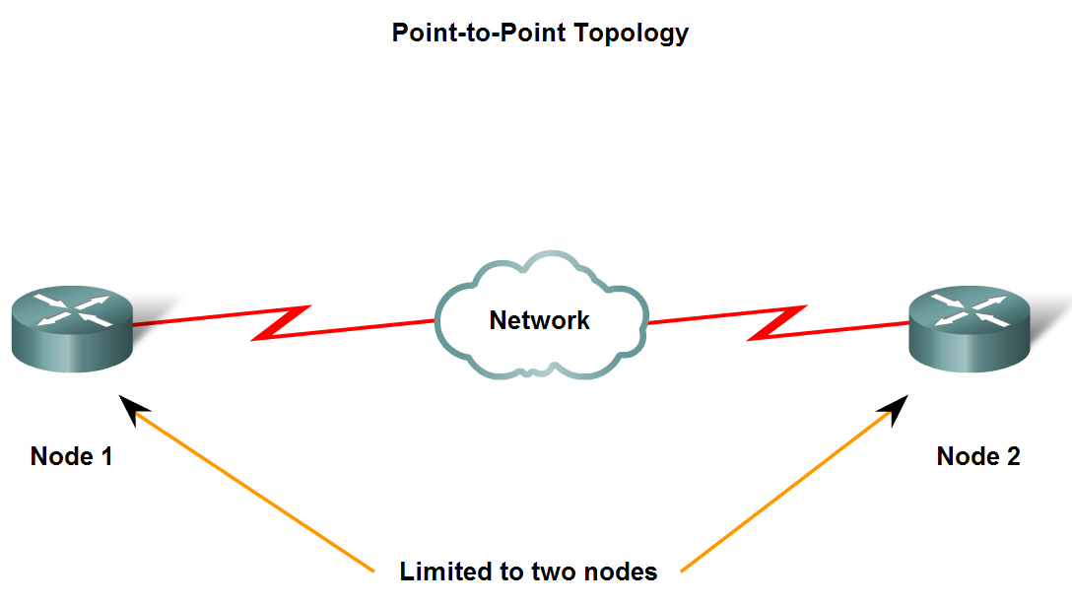
Media Access Control Techniques

Slide 15
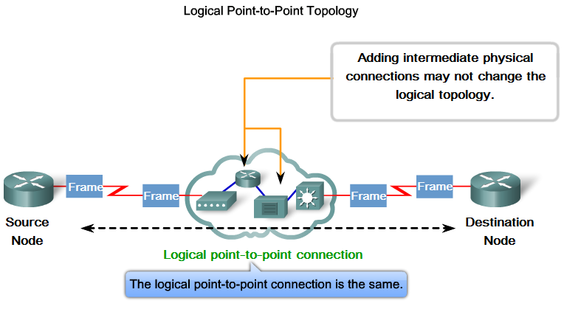
Media Access Control Techniques

Slide 16
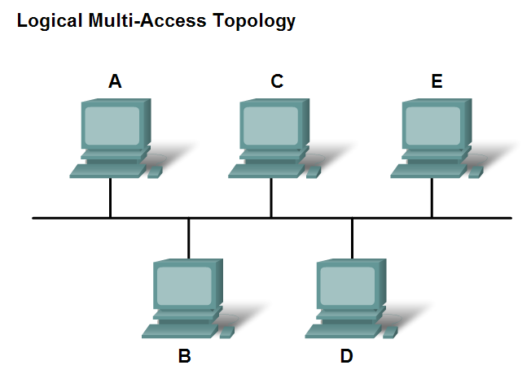
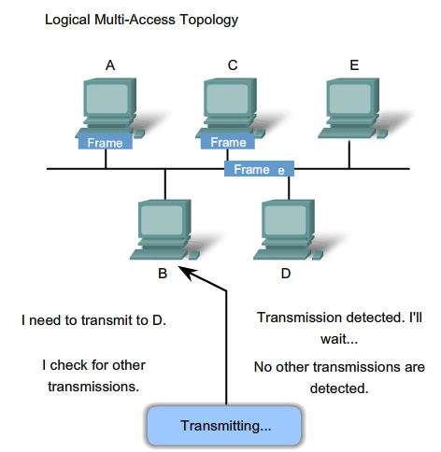
Media Access Control Techniques

Slide 17
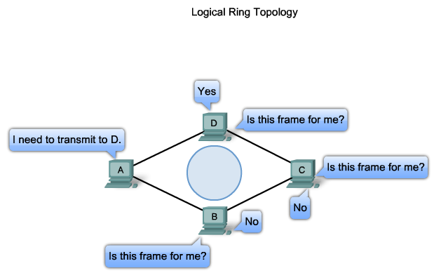
Media Access Control Techniques

Slide 18
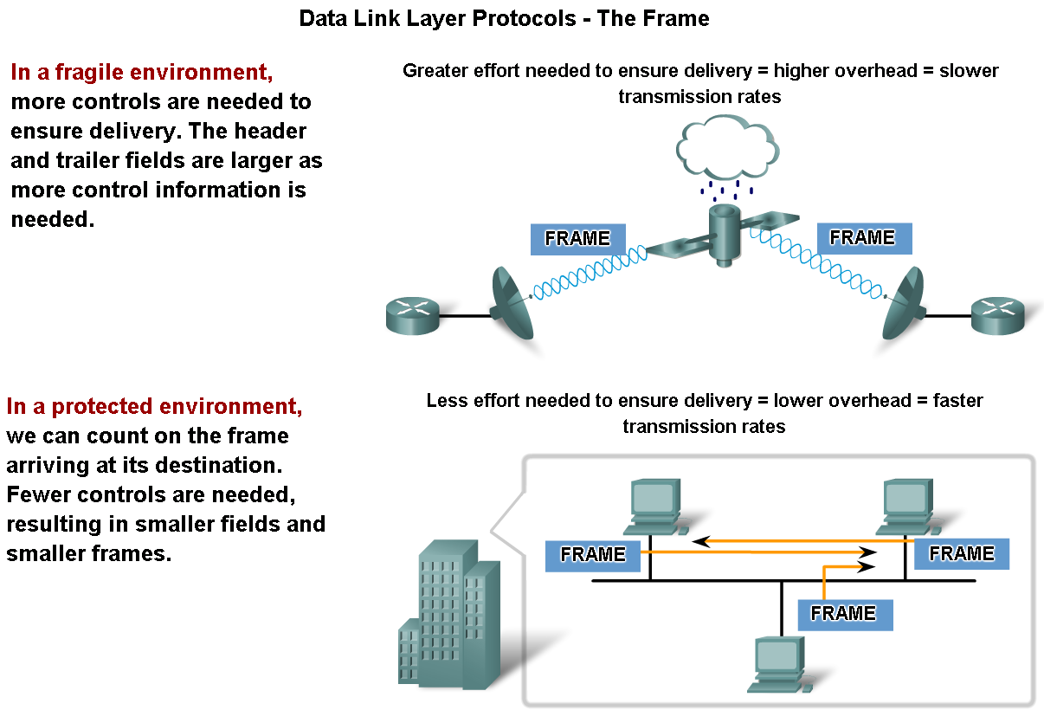
Media Access Control Addressing and Framing Data

Slide 19
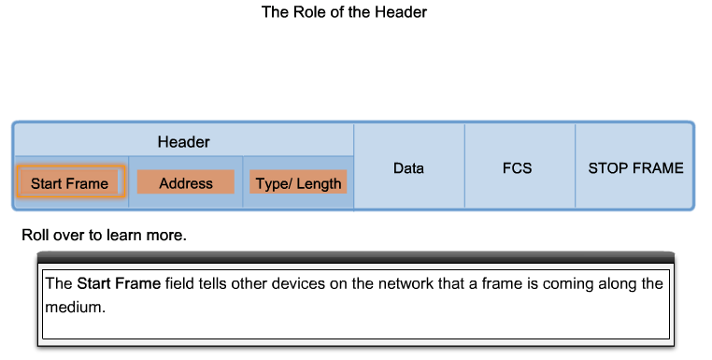
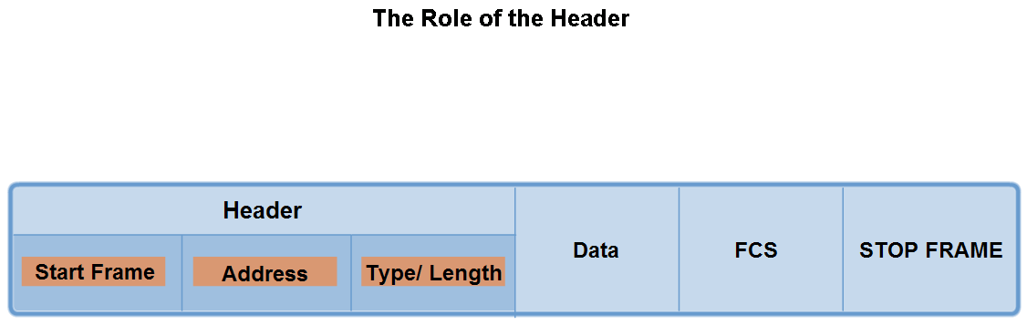
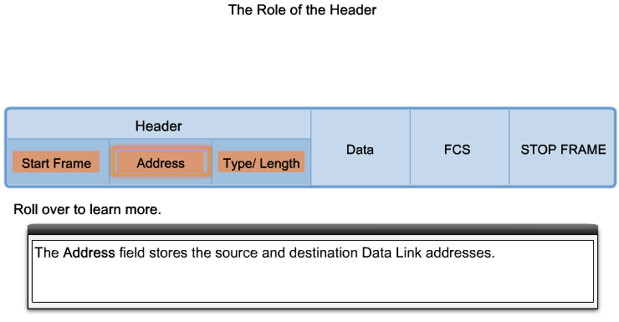
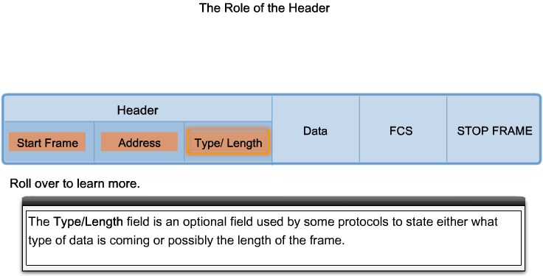
Media access control addressing and framing data

Slide 20
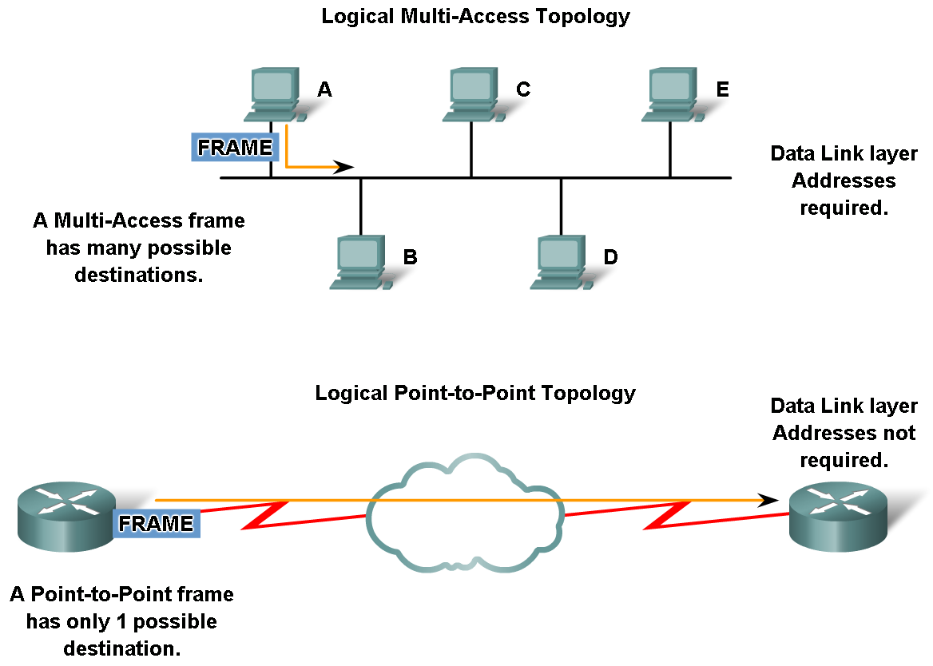
Media access control addressing and framing data

Slide 21
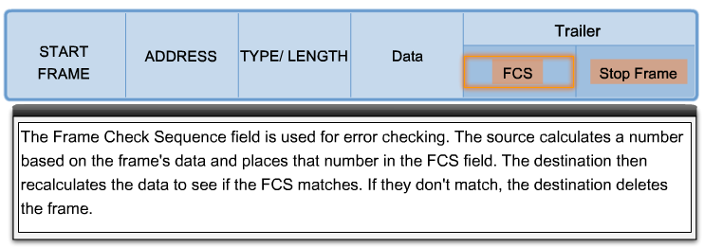
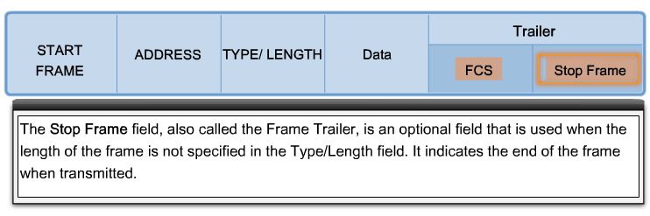
The role of the trailer

Slide 22
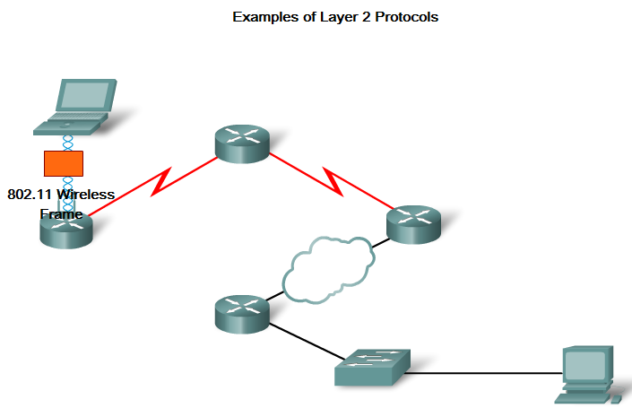
Example of layer two connection

Slide 23
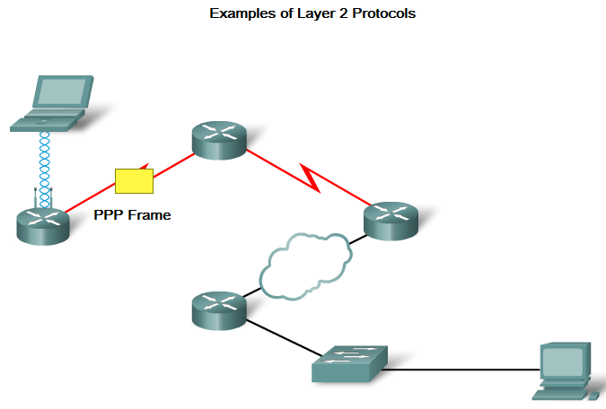
Example of layer two connection

Slide 24
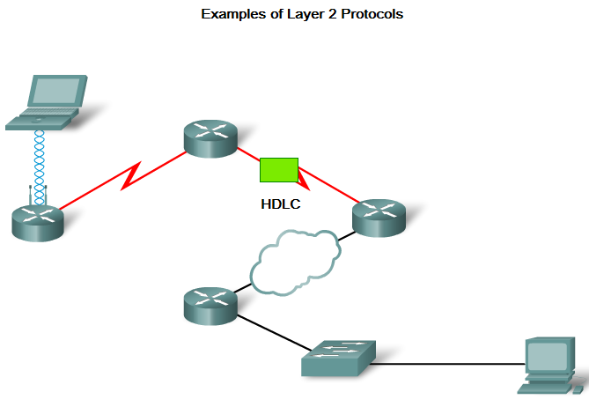
Example of layer two connection

Slide 25
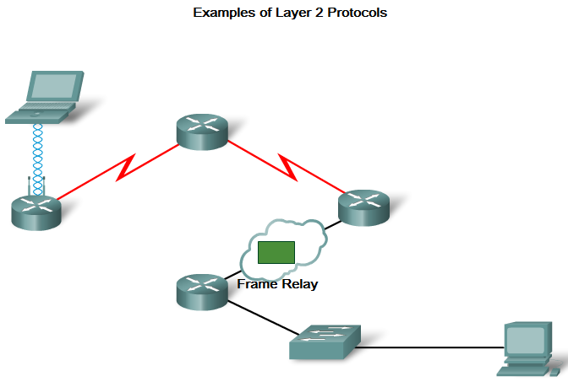
Example of layer two connection

Slide 26
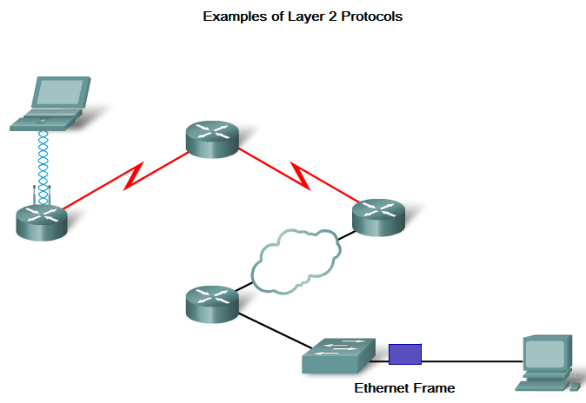
Example of layer two connection

