Slide 1
Cisco Routers
Presented By
Dr. Waleed Alseat
Mutah University

Slide 2
Cisco Routers models

Slide 3
How to choose the appropriate Cisco router
http://www.cisco.com/en/US/products/hw/routers/

Slide 4
Router Initialization

Slide 5
Router components
Router is typically like a computer which operates with
Two main components
Hardware (Router physical components )
Software (IOS)
Internetworking operating system.
configuration file

Slide 6
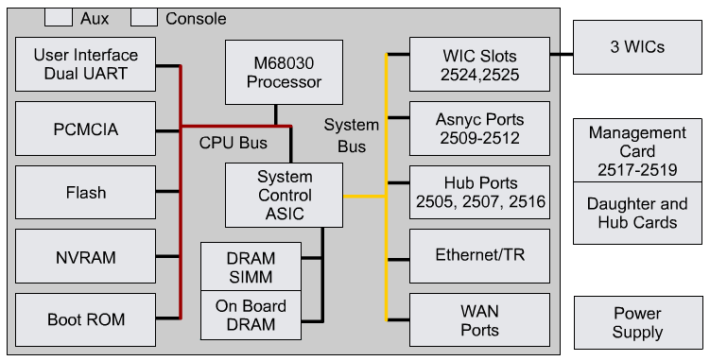
Router hardware components
Power Supply
CPU
Memory (RAM , NVRAM ,ROM ,Flash )
System bus
Interfaces

Slide 7
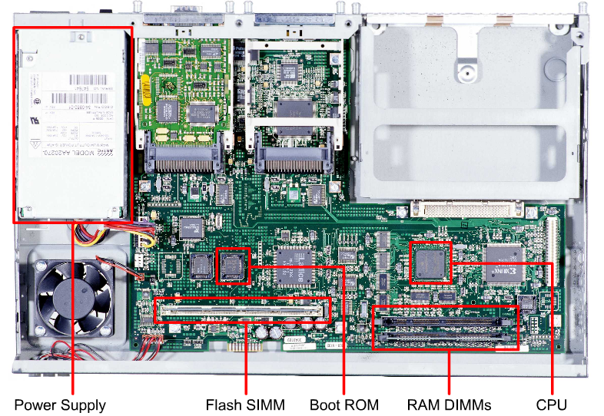
Router physical characteristics

Slide 8
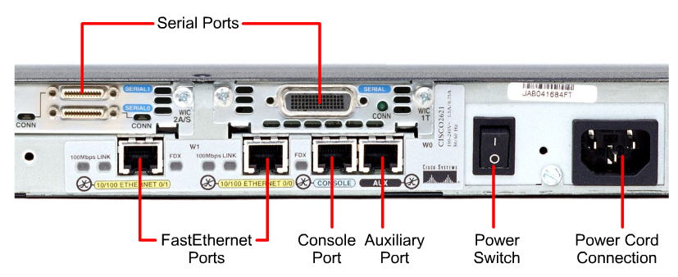
Router external connections

Slide 9
Ports and Interfaces
Port - normally means one of the management ports used for administrative access
Interface normally refers to interfaces that are capable of sending and receiving user traffic.
Note: However, these terms are often used interchangeably in the industry and even with IOS output.

Slide 10
Management Ports
Console port - Most common of the management ports
Used to connect a terminal,
Or most likely a PC running terminal emulator software,
No need for network access to that router.
The console port must be used during initial configuration of the router.
Auxiliary (AUX) port
Not all routers have auxiliary ports.
At times, can be used similarly to a console port
Can also be used to attach a modem.
Note: Auxiliary ports will not be used in this curriculum.

Slide 11
Router Interfaces
Interface on Cisco routers refers to a physical connector on the router whose main purpose is to receive and forward packets.
Routers have multiple interfaces used to connect to multiple networks which may mean:
Various types of networks
Different types of media and connectors.
Different types of interfaces.
For example, Fast Ethernet interfaces for connections to different LANs and also have different types of WAN interfaces used to connect a variety of serial links, including T1, DSL, and ISDN.

Slide 12
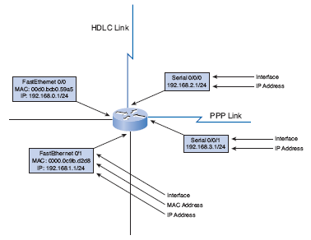
Router Interfaces
Every interface on the router:
Belongs to a different network
Cisco IOS will not allow two active interfaces on the same router to belong to the same network.

Slide 13
LAN Interfaces
Ethernet and Fast Ethernet interfaces.
Used to connect the router to the LAN, similar to how a PC’s Ethernet NIC.
Layer 2 MAC address
Participates in the Ethernet LAN the same way as any other hosts on that LAN.
Example: Address Resolution Protocol (ARP):
Maintains ARP cache for that interface
Sends ARP requests when needed
Responds with ARP replies when required
Typically an RJ-45 jack (UTP).
Router to switch: straight-through cable.
Router to router via Ethernet interfaces, or PC’s NIC to router’s Ethernet interface: crossover cable.

Slide 14
WAN Interfaces
Example: serial, ISDN, and Frame Relay interfaces.
Used to connect routers to external networks, usually over a larger geographical distance.
The Layer 2 encapsulation can be different types including:
PPP
Frame Relay
HDLC (High-Level Data Link Control).
Similar to LAN interfaces, each WAN interface has its own IP address and subnet mask, making it a member of a specific network.
Note: MAC addresses are used only on Ethernet interfaces and are not on WAN interfaces.
However, WAN interfaces use their own Layer 2 addresses depending on the technology.
Layer 2 WAN encapsulation types and addresses are covered later in the course.

Slide 15
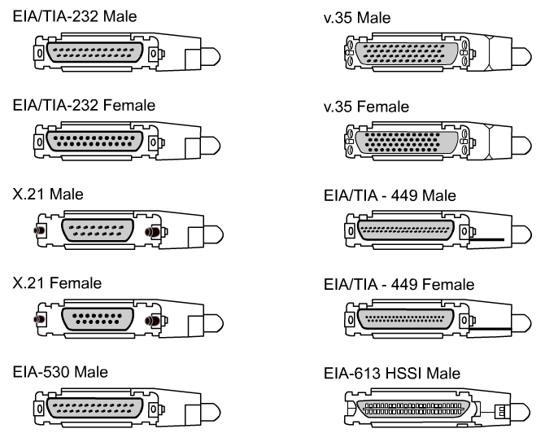
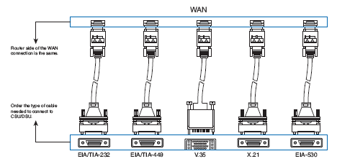
Serial Connectors
Cisco routers support the EIA/TIA-232, EIA/TIA-449, V.35, X.21, and EIA/TIA-530 standards for serial connections,
Memorizing these connection types is not important.
Just know that a router has a DB-60 port that can support five different cabling standards.

Slide 16
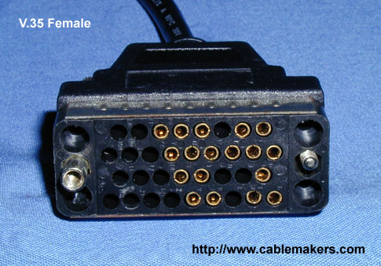
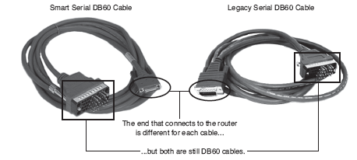
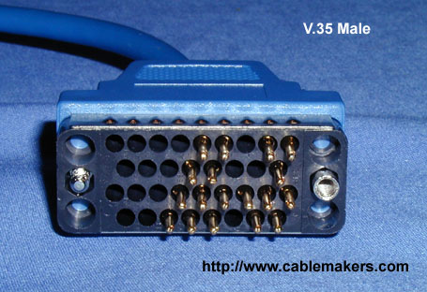
Serial Connectors
DCE Cable
DTE Cable
Router is typically a DTE device.
The DTE cable is connected to the serial interface on the router to a CSU/DSU device (DCE).

Slide 17
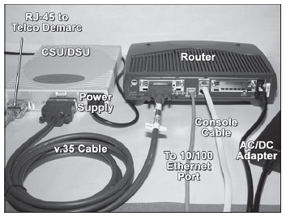
Physically Connecting a WAN Interface
Typically, the router is the DTE device and is connected to a CSU/DSU, which is the DCE device.
Serial interfaces require a clock signal to control the timing of the communications.
In most environments, the service provider (a DCE device such as a CSU/DSU) will provide the clock.
By default, Cisco routers are DTE devices

Slide 18
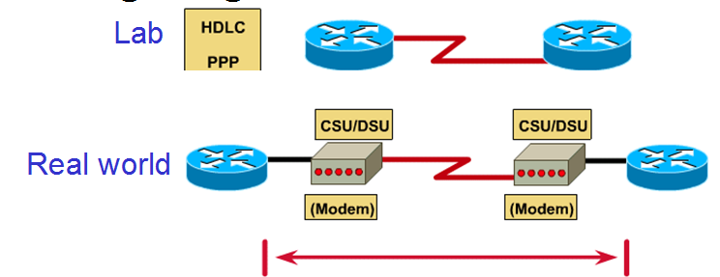
Serial Connectors
In our labs we will use serial DTE/DCE cables (no CSU/DSU) with a DTE cable connected to one router and a DCE cable connected to the other router.

Slide 19
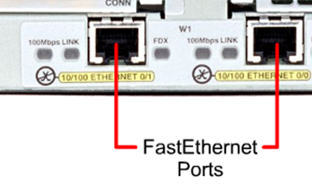
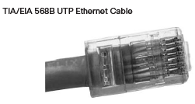
Ethernet Connectors
Straight-through cables are used for:
Switch-to-router
Hub-to-router
Switch-to-PC/server
Hub-to-PC/server
Crossover cables are used for:
Switch-to-switch
PC/server-to-PC/server
Switch-to-hub
Hub-to-hub
Router-to-router
Router-to-PC/server

Slide 20
Cisco Software components
Cisco IOS (Internetwork Operating System)
It is the operating system that manages the hardware
platform it is working on.
Configuration File
It is a program file that contains commands that
reflect how the router will react.

