Slide 1
University-Industry Research Partnerships

Slide 2
By Professor Salloom A. Al-Juboori B.Sc Mechanical Engineering Design (Baghdad University/ Iraq), M.Sc and PhD Applied Engineering Mechanics, (Leeds University/ U.K.)

Slide 3
Outline
Introduction
University-industry research partnering
Why? – motivation of the two partners
Research questions and findings
Conclusions and open questions

Slide 4
Introduction:
The purpose of the roundtable was to increase awareness of government financial, industry requirements with respect to skill gaps so that universities and training providers could deliver relevant programs and government entities could support with required policies and regulations.
The key findings of a Workforce Planning Study, which has identified some of the major themes and skills gaps within the fast-growing Industry finance sector, Industry Economy was launched in 2015 and is based on three pillars steps, these steps may worth to be mentioned: -

Slide 5
First steps:
The hub of Industry Finance, then the industry needs assistance from Professional Industry Finance experts .
Industry Finance is a growing market. It is growing fast .
The Industry side needs to lead the shift towards an Industry Economy 􀍴 They should instruct academic institutions on the various courses and Skills/qualifications they require from graduates.
In order to build on a globally recognized Industry Economy .

Slide 6
They cannot work in silos. Government, industry and academics need absolute transparency in order to work together. A large talent pool exists which should be tapped into. The triple partnership of regulators, academics and employers is crucial to the success of this hub.
Having an Industry ethos is important for a company, not just offering Industry products, the way a company conducts business and its Practices needs to keep in mind Industry values and traditions .
Universities and companies need to invest in research in industry Finance which will help grows the industry and talent pool.
Industry Finance should be taught to students from grass root levels.
Universities will respond to market needs if they are made aware of them. Informing the academic sector of market needs should be the
Responsibility of Industry .
Accreditation and certification are very important when institutions are promoting Industry Finance courses or services.

Slide 7
Internship programs need to be offered by banks, Universities need to develop better career guidance programs.
Government has to play a very big role in developing the Industry Economy in order to meet its vision .
The baseline level for academic qualifications is very high: recruiters will look for experience, internships, written papers and additional areas that make a graduate stand out.
Is vocational education the answer for a quick response to the needs of the Industry Economy? Do we need quicker diploma programs over degrees?

Slide 8
Second Steps
There needs to be more frequent networking events and opportunities for government, industry and academic sectors, in order to have greater transparency with key stakeholders in the Industry Economy.
Using the Government investing in research and other areas within
the Industry Economy, it may help develop the infrastructure at a
quicker rate.
Industry, especially financial institutions, should look to offer more
internship opportunities to graduates to ensure better development
of human capital.

Slide 9
Universities should plan to offer more degrees in Industry Finance 􀍴 whether these are dedicated degrees or streams within existing degrees.
A committee should be initiated which includes academia, banks and the government, in order to create a fund to support the Industry Finance sector.
In order for University to realize Industry, government and academic institutions need to work closer together and plan to develop trained professionals within the Industry Finance sector.

Slide 10
Third Steps:
Have an important role to play in bringing academia, industry and government closer together to ensure the future success of the sector.
Partners and training institutes to tailor their education programs to the demands of local business. This is a smart and forward-looking approach to education 􀍴
Shortage in the sector, but also provides a platform to discuss innovative ways to encourage sustainable and long-term skills development. At present, there are a number of institutions in society offering programs in banking and finance;

Slide 11
In the future, there will be an increasing focus on excellence in all aspects of employment, and this will be particularly true for those working within Industry finance. To prepare for this, universities and training providers must refine their programs and courses to support the sector, equipping young talent with the level of specialism and sophistication that is required by employers.

Slide 12
Quotes from University-industry research partnering In Advanced Industrial Countries:
Long history – more than 100 years old, both in agriculture and manufacturing.
Increase in past 10-20 years restores strong links from the first half of the twentieth century .
Current partnerships have a wide variety of organizational forms .
Still a relatively small fraction of university research funding (for example, in some countries (~6 to 7 percent).

Slide 13
Variety of partnership types
Industry support of particular university researchers via grants and consulting.
Large laboratories funded by industry consortia involving 10s to 100s of firms, in U.S for example .
Quasi-permanent, partially funded by government.
Onetime projects that involve a university as a partner
Ordinary research joint venture (RJV) with specific goal .
Government cost-shared RJV,.

Slide 14
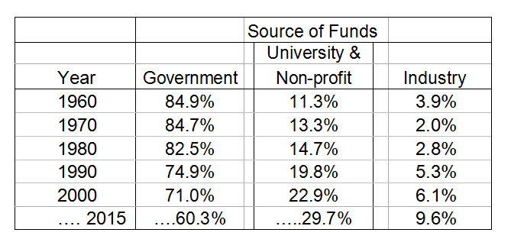
Trends in university funding in the United States

Slide 15
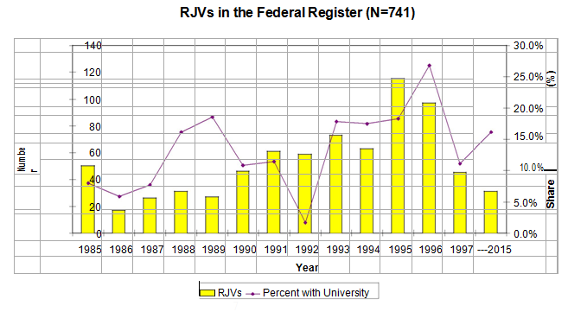
U.S. Research Joint Ventures

Slide 16
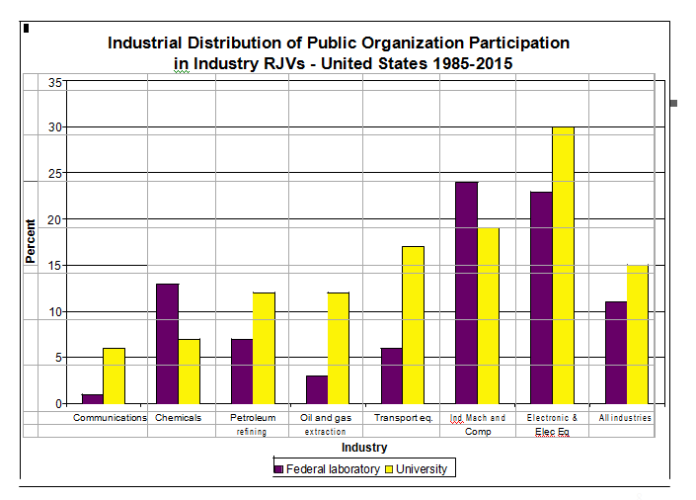

Slide 17
Benefits to Industry
Access to new and complementary research .
Development of new products .
Maintaining a relationship with the university .
Obtaining new patents .
Solving technical problems .
Less important improving products, recruiting Students .

Slide 18
Benefits to Faculty
Funds for research assistance, lab equipments, and one’s own research agenda.
Insights into own research; field test theory and empirical research .
Less important Practical knowledge useful for teaching Student internships and job placement
Patentable inventions and business opportunities .
Variation across research field .

Slide 19
Evaluating the benefits
Access to university research enhances sales, Research and development (R&D) productivity, and patenting .
Collaborating (publishing) with “star” university scientists important for firm performance in biotechnology .
Industry -University Cooperative Research Centers promote tech transfer and increase patenting rates at industrial laboratories.
University research enhances and stimulates (R&D) in industry, rather than substituting for it.
Augments capacity of business to solve complex problems .

Slide 20
Why has partnering Should be increased?
Industry Motivation:
Universities become more important as technical change is closer to “science.”
Declines in direct industry spending on basic research following the wave of corporate restructuring in the 1980s .
Special basic research tax credit should be introduced .
Currently in some countries a tax credit equal to
20% of payments to a “qualified” research organization (university or non-profit) is available to
taxpaying firms .

Slide 21
Why Has Partnering Should Be Increased?
University motivation – changes in government levels of support
Funding in U.S for example:
16% between 1953 and 1968
1% between 1969 and 1983
7% between 1984 and 2015, but with substantial declines in non-biomedical areas
As governments funding declined, universities used more of their own funds and more funds from industry .
University administrators increasingly pressure faculty to engage in applied commercial research.

Slide 22
Motivation for our study
Increased reliance of industry on partnerships with universities for the performance of R & D – important to understand what works and what doesn’t .
Want to evaluate performance aspects of the Advanced Technology Program (cost-sharing for pre-commercial R & D with industry).
Concern that such partnerships may be difficult to consummate or may not perform as well as we would like – what are the reasons for this?

Slide 23
Causes of Early Termination of Projects :
More likely if the project did not include a university participant .
Less likely if government share of funding was high.
More likely if lead partner was a midsized for-profit firm (rather than very small or very large).

Slide 24
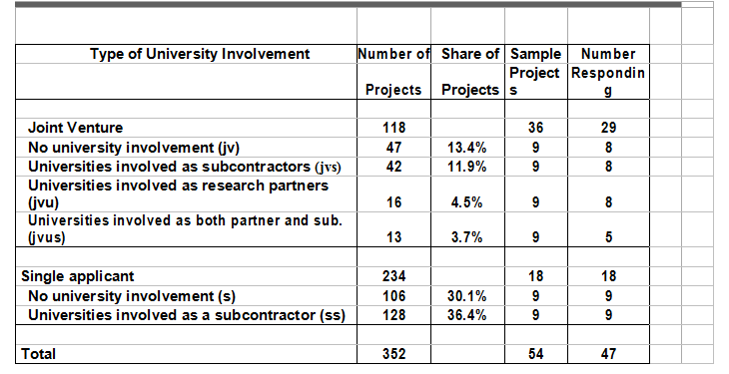
Type of university involvement in U.S
8.2% had university partner; 56.5% had some university involvement

Slide 25
Research questions
Are there systematic differences in the research performance within -funded projects that have university partners and those that do not?
Are there identifiable barriers that inhibit universities from partnering with industry?
Are there identifiable barriers that inhibit industry from partnering with universities?

Slide 26
Differences in research performance within projects with and without university partners?
Research Performance = f (budget, size, technology, University participation, controls)
Where Research Performance is defined as :
Difficulties acquiring and assimilating basic knowledge - Projects reporting greater likelihood of experiencing difficulties have university involvement.
Unexpected research problems - Truly unexpected.

Slide 27
Productive use of research time and financial resources - Technology specific – personnel problems in frontier technology; equipment problems fewer in info technology; more unproductive time/cost in electronics.
New applications of technology - Nothing can predict this.
Sooner-than-expected commercialization of the technology - Projects less likely to commercialize sooner than expected have university involvement.

Slide 28
Summary of research performance findings
Universities are included (e.g., invited by industry) in those research projects that involve what we have called “new” science.
This type of project encounters more difficulty in assimilating knowledge.
Such research will not commercialize sooner than expected.
Nor is it likely to terminate early

Slide 29
Identifiable barriers that inhibit universities from partnering with industry?
Most significant barrier that inhibits research partnerships with industry—as a joint venture member or as a subcontractor—related to intellectual property concerns, specifically patenting rights.
Universities want to be able to patent whatever research results from their partnering relationship, but found industry extremely difficult to deal with on this issue; publication rights were, for the most part, an non-issue from the perspective of the university.

Slide 30
2) Small companies tended to subcontract with universities rather than include them as a research partner. Universities reported a higher false start rate with small companies primarily because they seemed less familiar with the university bureaucracy. (Less tolerant of?)

Slide 31
Identifiable barriers that inhibit industry from partnering with universities?
Often a stumbling block for collaborations because many universities want to publish results prior to protection, and sometimes will not grant exclusivity of results.”
“Universities have an over-inflated view of their intellectual property value, and university licensing officers have an over-inflated view of the value they bring to the project.”

Slide 32
Thank You For Your Attention

